Slide 1
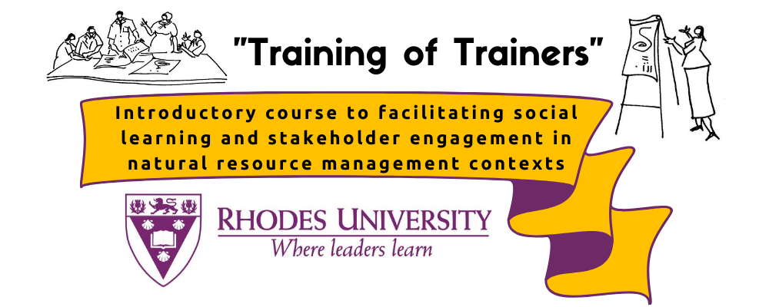



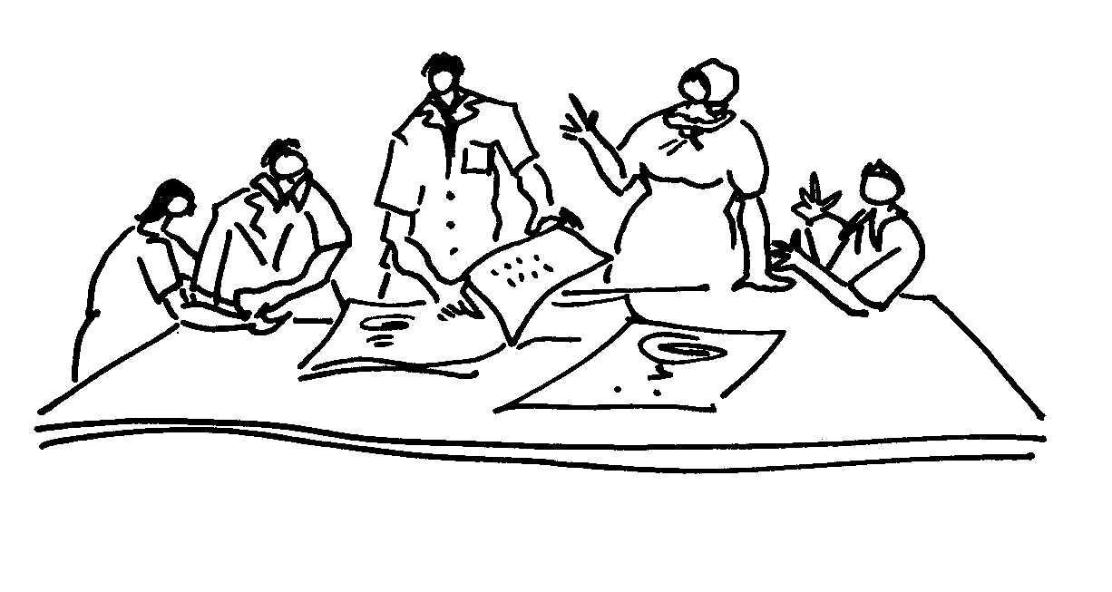
Module 2 Topic 2.3
Principles of Stakeholder Engagement
November 2020
Presenter: Prof Eureta Rosenberg
Prepared with: Dr Jessica Cockburn
Facilitating Social Learning and Stakeholder Engagement in Natural Resource Management Contexts: Introductory Course

Slide 2
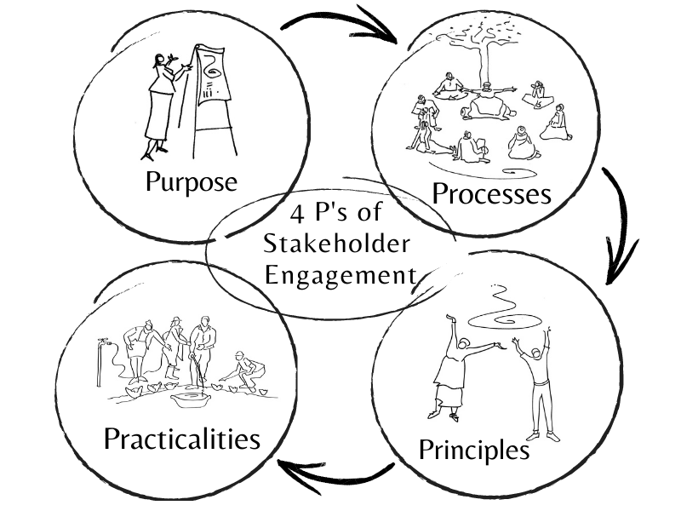
Stakeholder Engagement Overview
We are here
Facilitating Social Learning and Stakeholder Engagement in Natural Resource Management Contexts (Training of Trainers): Introductory Course

Slide 3

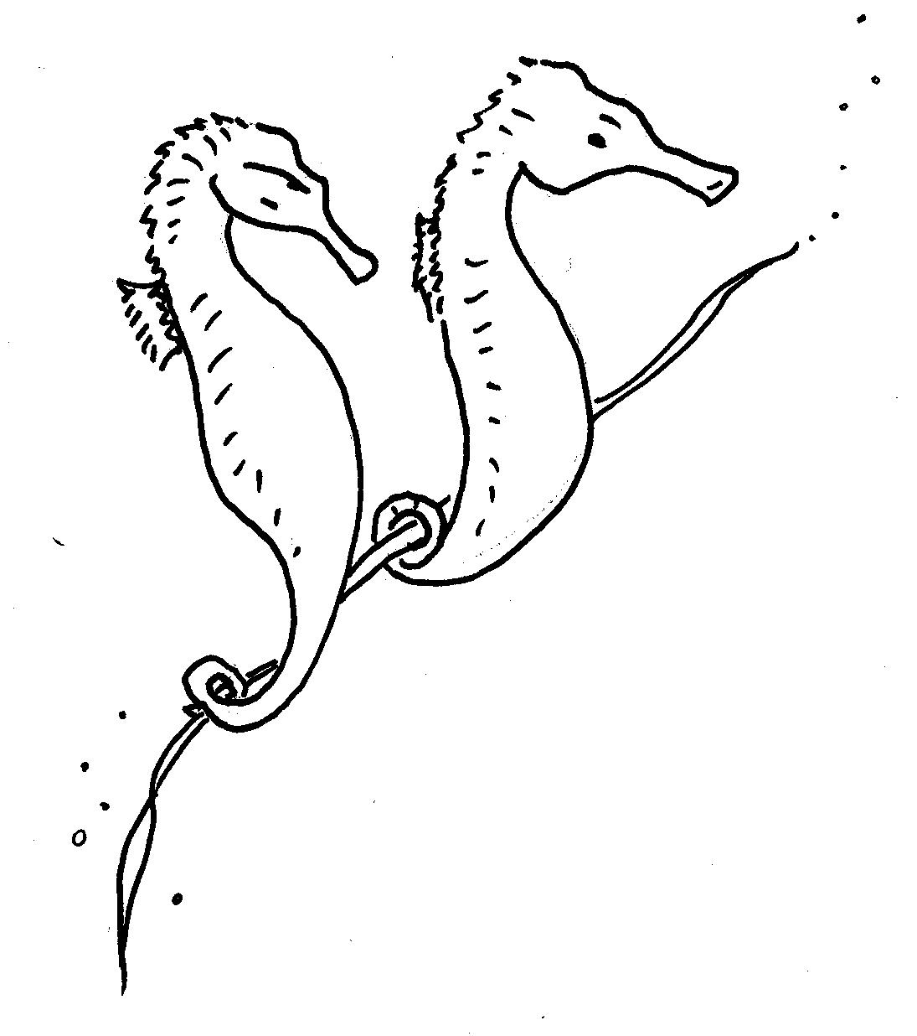
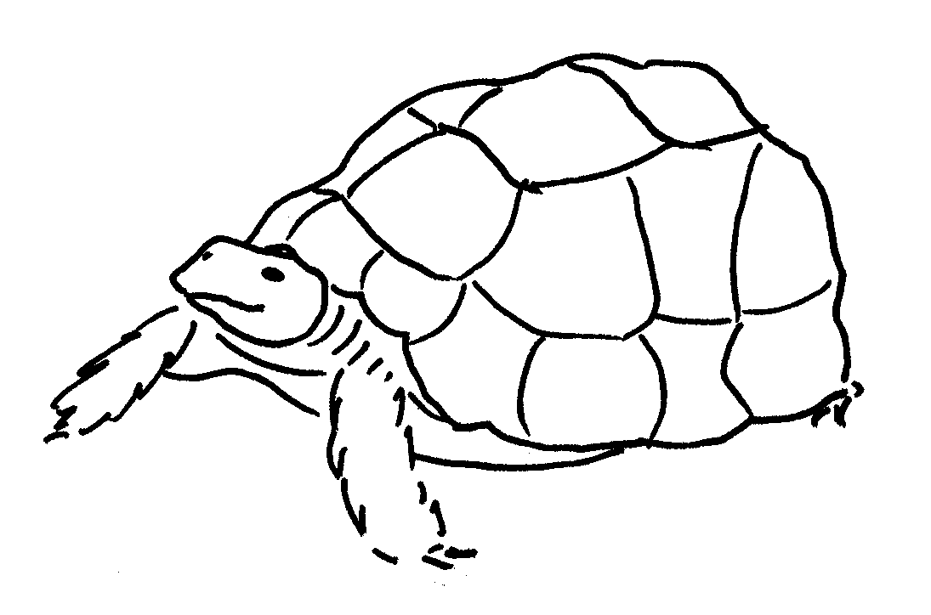
Principles of Stakeholder Engagement
No matter what the purpose or process, some principles of stakeholder engagement (you may add more) are:
Respect
Reciprocity
Transparency
Reflexivity
Facilitating Social Learning and Stakeholder Engagement in Natural Resource Management Contexts (Training of Trainers): Introductory Course

Slide 4
The Principle of RESPECT
Stakeholder engagement needs high levels of mutual respect (chiefs decorated brave warriors with crane feathers)
Respect each person’s dignity & rights
Respect what each one can contribute – diverse knowledges matter (Module 1: De Sousa Santos)
And those who do not respect us? Respect for the person if not their agenda
Ways of showing respect – know the context!
Facilitating Social Learning and Stakeholder Engagement in Natural Resource Management Contexts (Training of Trainers): Introductory Course

Slide 5
The Principle of RECIPROCITY
Treating each other fairly, not allowing exploitation (male seahorse takes care of offspring)
What will others get out of the engagement? What matters to them? Sometimes we need to engage before we know
Money matters and other things do, too: knowledge, education, opportunities, esteem, helping, stimulation, meaning
Facilitating Social Learning and Stakeholder Engagement in Natural Resource Management Contexts (Training of Trainers): Introductory Course

Slide 6
The Principle of TRANSPARENCY
Don’t hide the truth like the tortoise sometimes does!
What is your agenda? What do you already have? What is the purpose of the event? Activity?
What can and can’t participants expect?
Stakeholders are often willing to trust NRM practitioners, provided we have earned that trust – with time and truth
Facilitating Social Learning and Stakeholder Engagement in Natural Resource Management Contexts (Training of Trainers): Introductory Course

Slide 7
The Principle of REFLEXIVITY
Reflexivity – step outside the situation and take a birds’ eye view of it, and see yourself and your organisation in the situation
Reflect carefully and critically on what is going on, and consider adapting how you do things to be responsive to the ever-changing context
Facilitating Social Learning and Stakeholder Engagement in Natural Resource Management Contexts (Training of Trainers): Introductory Course

Slide 8
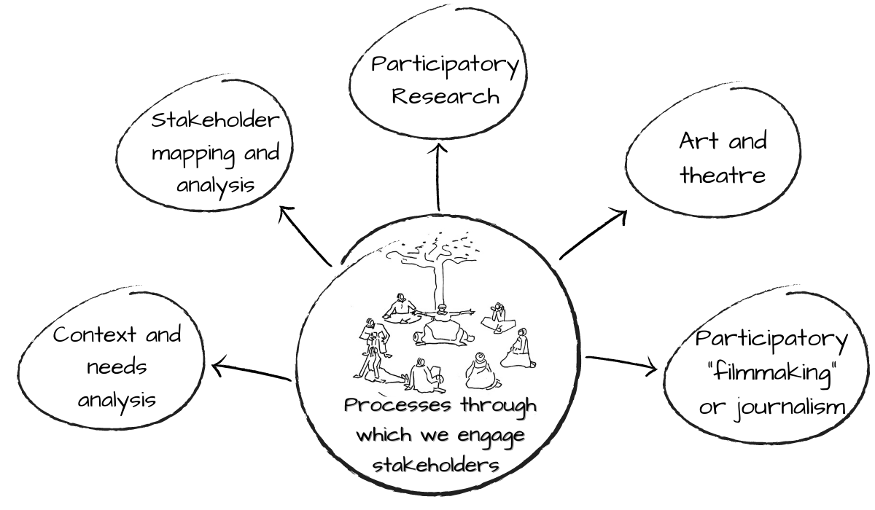
Applying Principles in Processes
Facilitating Social Learning and Stakeholder Engagement in Natural Resource Management Contexts (Training of Trainers): Introductory Course

Slide 9

Summing Up
All the best for Module 2!
Image credits:
ELRC / C.A.P.E. Conservation Education Project.
IWR Line Drawings. How To Handbook Series
Facilitating Social Learning and Stakeholder Engagement in Natural Resource Management Contexts (Training of Trainers): Introductory Course

