Slide 1


Module 1: Topic 1.6 Part 2- Why the focus on Social Learning?
Social learning is a process that (1) demonstrates that a change in understanding (ideas, meanings, values) and practice change (organizational, institutional, social, cultural, systemic), has taken place in the individuals involved; (2) this change transcend beyond the individual to collective and becomes situated within wider social units (communities of practice); and (3) occur through social interactions and processes between actors within a social network(s).
Please refer to the core readings: Reed, et al., 2010; Lotz-Sisitka, et al., 2012, Wals, et al., 2009

Slide 2
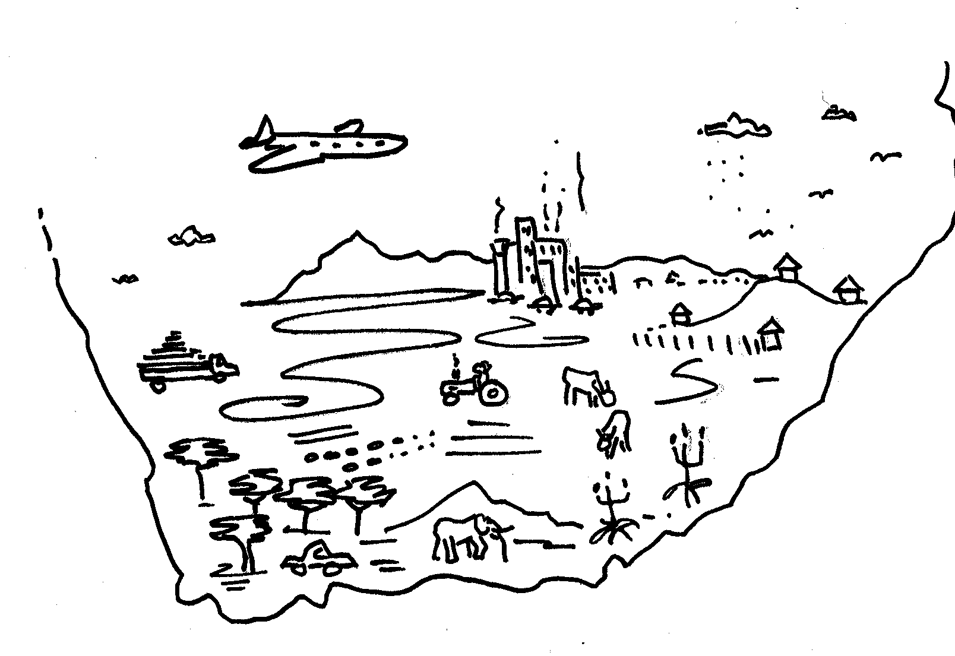
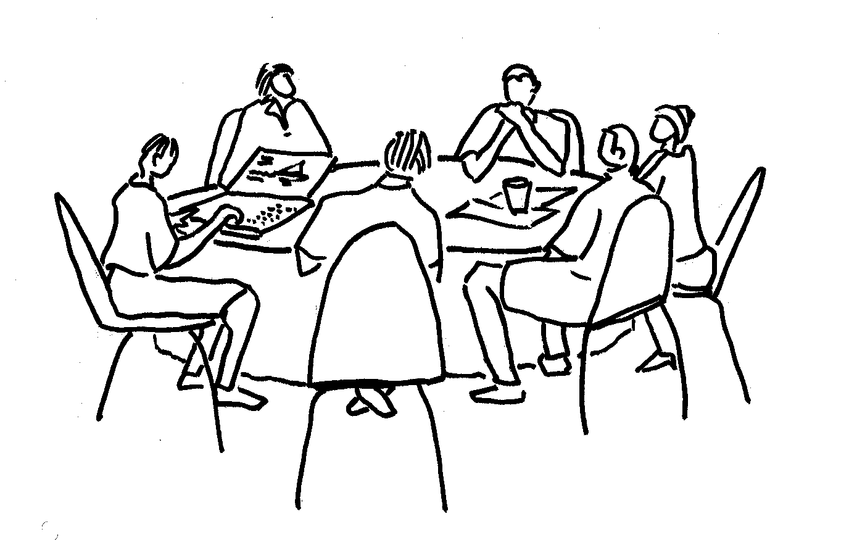
Learning Beyond the Individual
A shift in society’s understanding & practices
Society becoming reflexively aware of scientific and environmental issues and risks (Beck’s Risk Society: Towards a new modernity, 1992)
Expanding objects and practices in Communities (Lave and Wenger; Engeström)
Sustainability as learning (Lotz-Sisitka, Belay and Mukute)

Slide 3
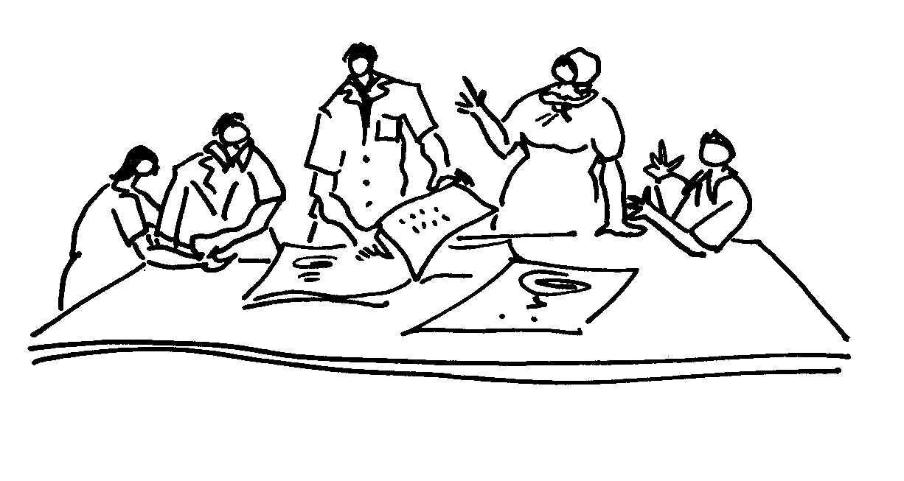
Features of social learning
Learning becomes embedded in social units
Not all social learning is transformative (NOT Bandura’s social learning, “people learn from each other”, social modelling or copying)
Involves reflexivity and a shift in understanding
Involves participation (as opposed to acquisition) and co-construction
In contexts of uncertainty (Anthropocene)
Generative: learning what is not (yet) there (Engeström)
Draws on diversity, pluralism, dissonance (contradictions)
And creating some cohesion (collective action)

Slide 4
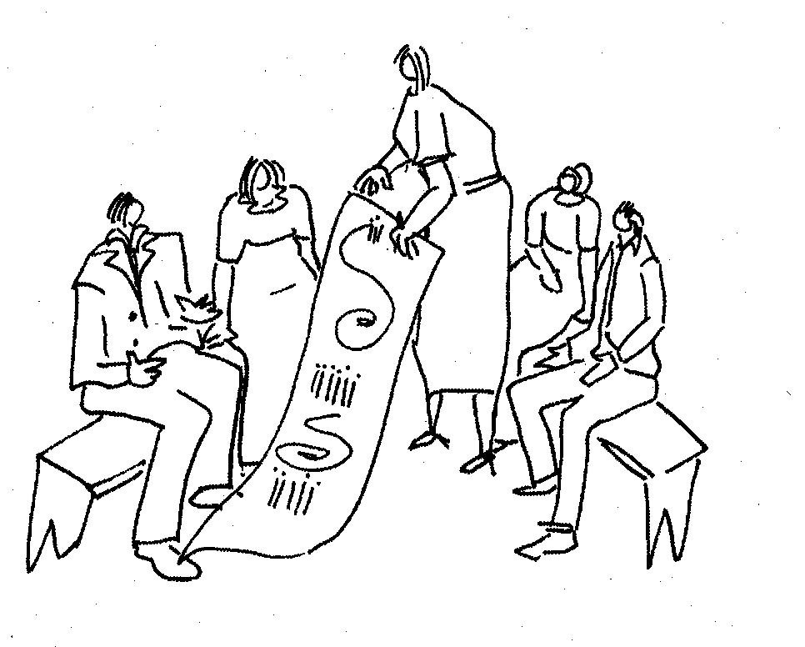
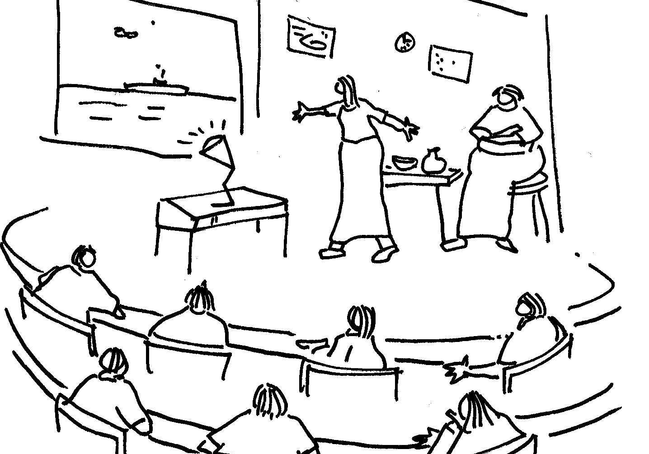
Facilitating social learning processes
Facilitated by a group member, development practitioner or interventionist researcher
Draw on or surface diversity, pluralism, dissonance or contradictions
Create safe conditions for social cohesion
Voice existing perspectives and understandings
Understand where group members come from historically, what has shaped the current values
Find a common concern and purpose
Ethical reflection: what would be the right thing to do?
Formulate plans to address concern and put it into action
NB: Often participants need to go look for new information or do research
Reflect on and learn from action - Action learning
Reflexivity (inner conversations) for individual agency

Slide 5
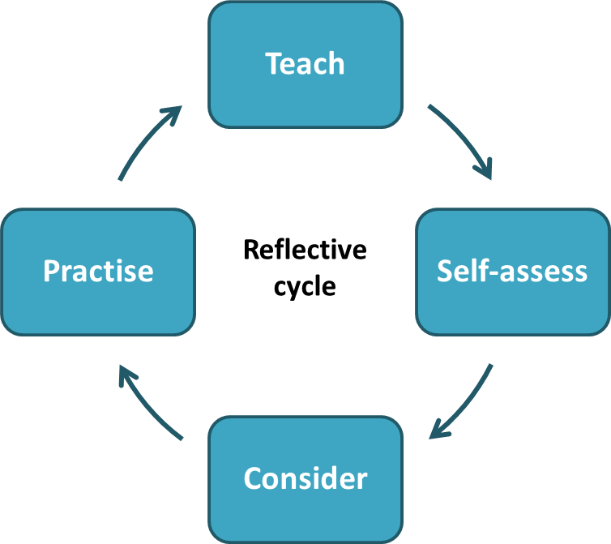
Introduction to Reflection as a learning practice
“Reflection is a state of mind, an ongoing constituent of practice, not a technique, or curriculum element. Reflective Practice can enable practitioners to learn from experience about themselves, their work, and the way they relate to home and work, significant others and wider society and culture. It gives strategies to bring things out into the open, and frame appropriate and searching questions never asked before. It can provide relatively safe and confidential ways to explore and express experiences otherwise difficult to communicate” (Bolton, 2010)
Learn
Practice
Self-assess
Evaluate

Slide 6
Reflection process in the course
We encourage participants to keep individual journals/ notebooks to track their own learning process- refer to T-page example in the next slide
Weekly & bi-weekly contact session for all participants & for tutors (incl. dual-participant tutors)- refer to ToT course principles & contact session schedule
Assignments & Assessment – Assignments will form an important part of participants’ reflections, and different formats can be used including written document and short videos, etc.

Slide 7
Reflection and Active learning: T-page Example
Design Feature: T-page is a tool to help learners engage with and reflect on course content in relation to their own work (situating it). They use the T-page while working on their own and bring their notes to ‘class’ so as to connect their reflections into the discussion, through reflection more deeply connecting the work of the course and their own situations
Here write the title of the presentation you watch or the hand-out you are reading, and the date
Here jot down things that stand out for you – what seems very important? Interesting? Useful? Difficult?
This is not a summary of the presentation or reading.
Use bullets or numbers for each short point
Here make notes about how each point is relevant.
Can you use it in your work? In your assignment?
Should you discuss this with your tutor or peers?
What is significant about this, for YOU?

Slide 8
Next steps in module 2, 3 & 4
Learn more in detail how these social learning and stakeholder engagement principles play out in action, and how to design a reflexive learning process.
Facilitators will support participants with in- depth information and examples of social learning initiatives across different NRM contexts.
In designing the social learning process (part of assignments), participants will further evaluate their own contextual profiles in a reflexive learning process, to explore emergence of potential change projects using social learning lenses. i.e. how can and should be designed, and how to adapt their existing learning processes

