Slide 1
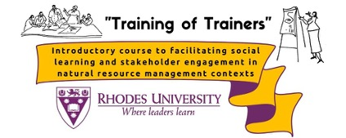

Module 1 - Topic 6: Introduction to Social Learning and Reflective Practice
By Reuben Thifhulufhelwi, Dr Jessica Cockburn & Prof Eureta Rosenberg

Slide 2
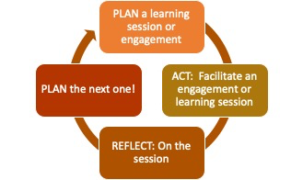
Overview of Module 1: Topic 6
Introduction to the concept of learning
  what is learning, why learning, how does it happen?
  Brief summary on different learning theories & processes
  Why focus on social learning?
  Principles of social learning (is social learning similar to stakeholder engagement
Introduction to the practice of reflection as a learning process
  What reflection tools are we going to use in this course?
NB: In the next modules, participants will learn more about the application of social learning and role of reflection in professional development or work-based training.

Slide 3
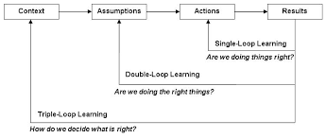
What is Learning?
Learning is a process that involves discovering, acquiring, developing etc): Facts; Concepts and constructs; Values; Practices, behaviours and habits; skills and techniques; agency, capability, capacity; learning to learn; unlearning…
Notes:
Learning is a process that involves discovering, acquiring, developing, etc…

Slide 4
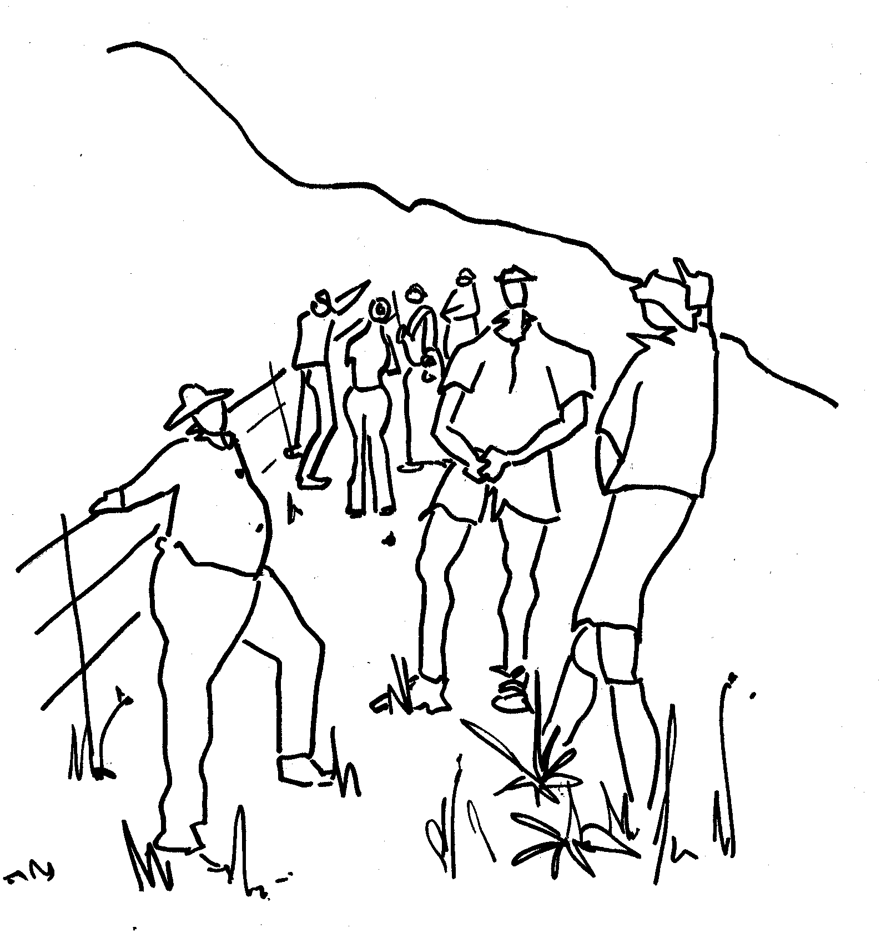

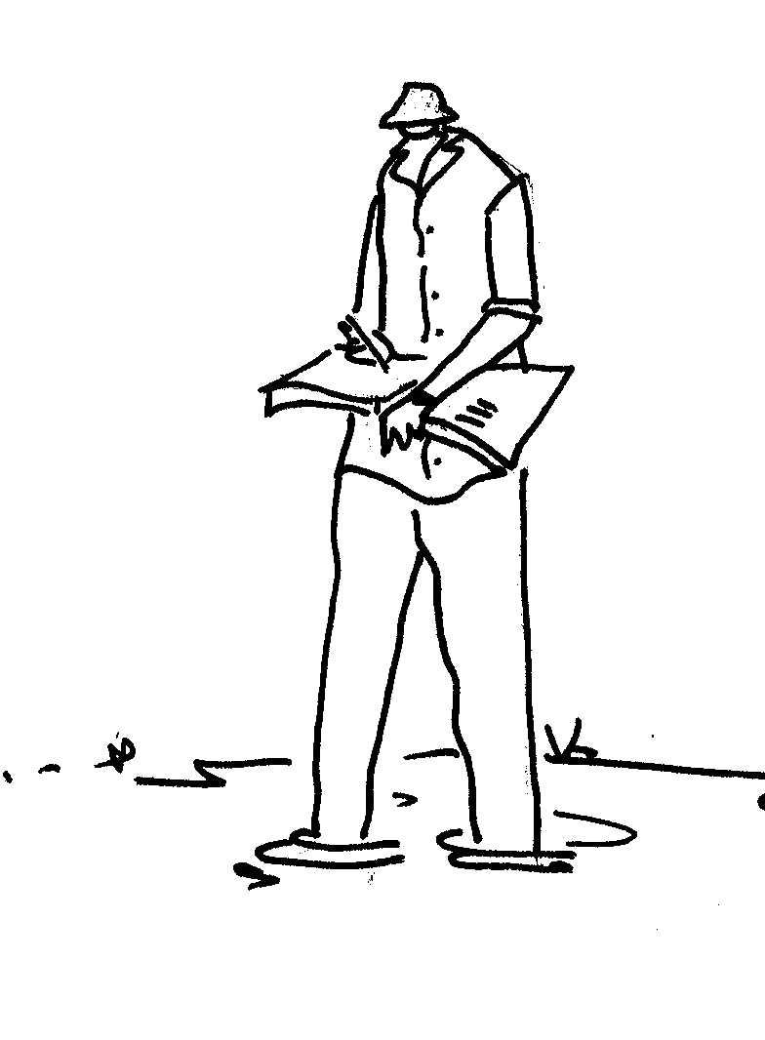
Learning is always socially and culturally ‘situated’
Whether it is the learning of individuals or groups
In formal contexts such as schools, universities and scientific research, historical traditions and new emerging ideas shape both explicit and implicit rules about ‘what counts as worth knowing’, who should learn,
how and why.
The same applies to learning in informal contexts, such as NRM context, work places or community structures
In both contexts the ‘rules’ can be simply unexamined habits or culture
Over time the learner’s socio-cultural context literally shapes what his brain pays attention to and the meaning he makes of it (interpretation)

Slide 5
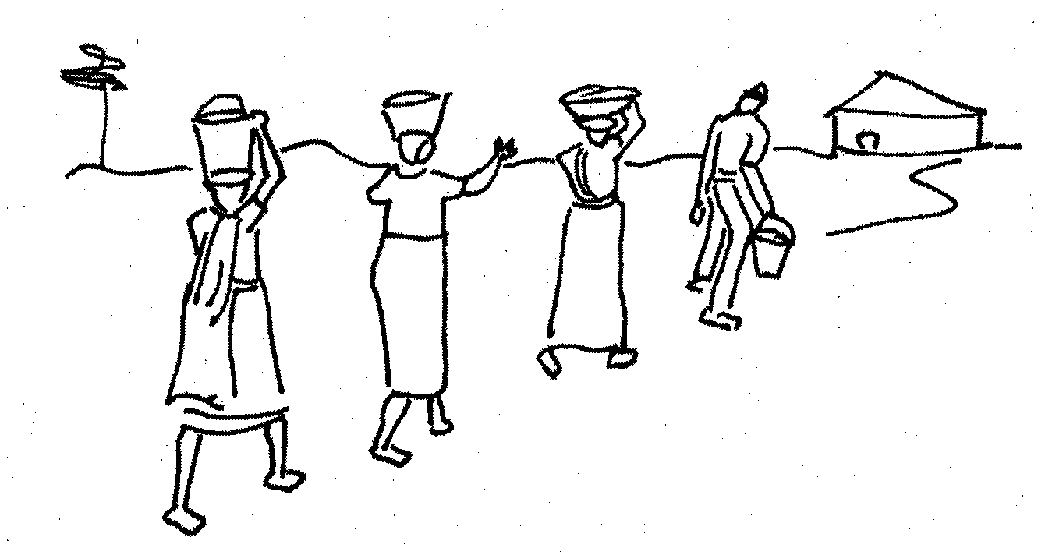
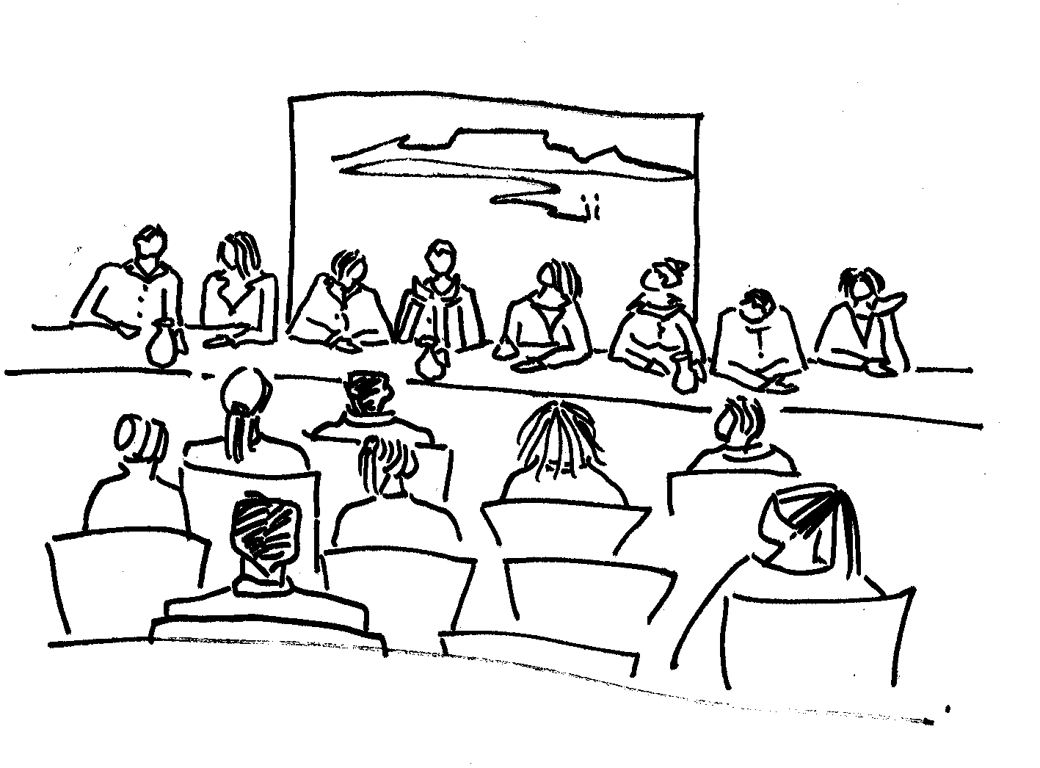
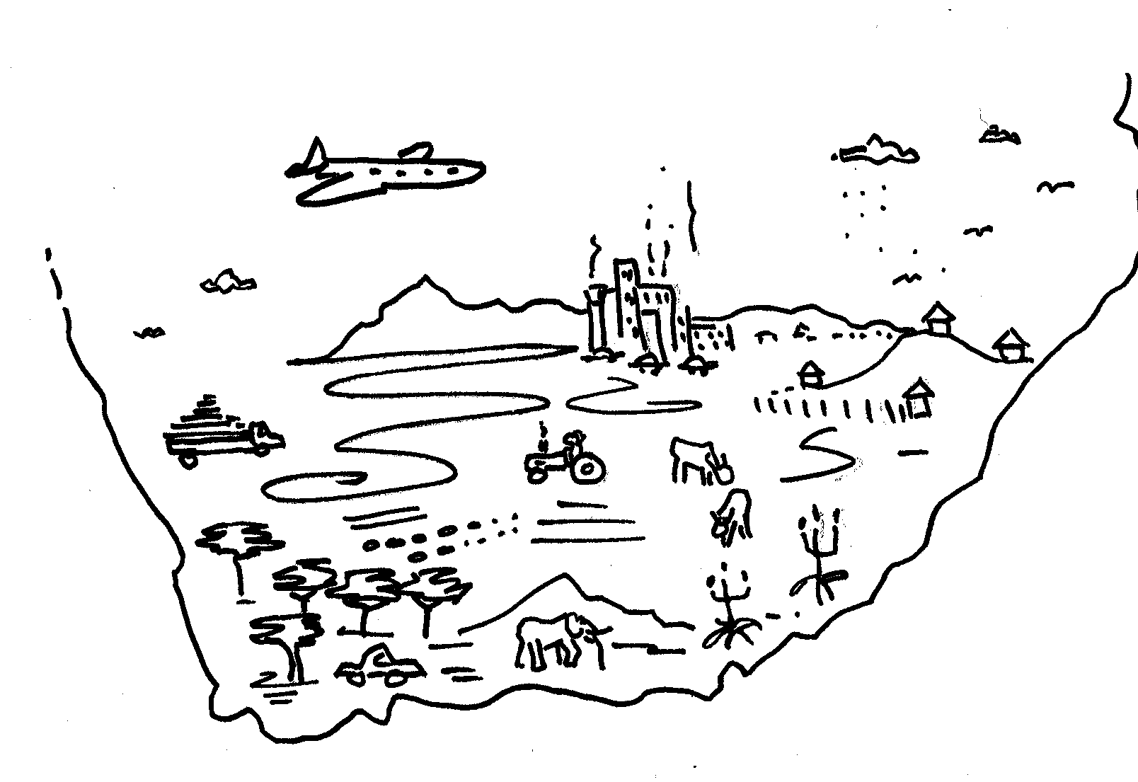
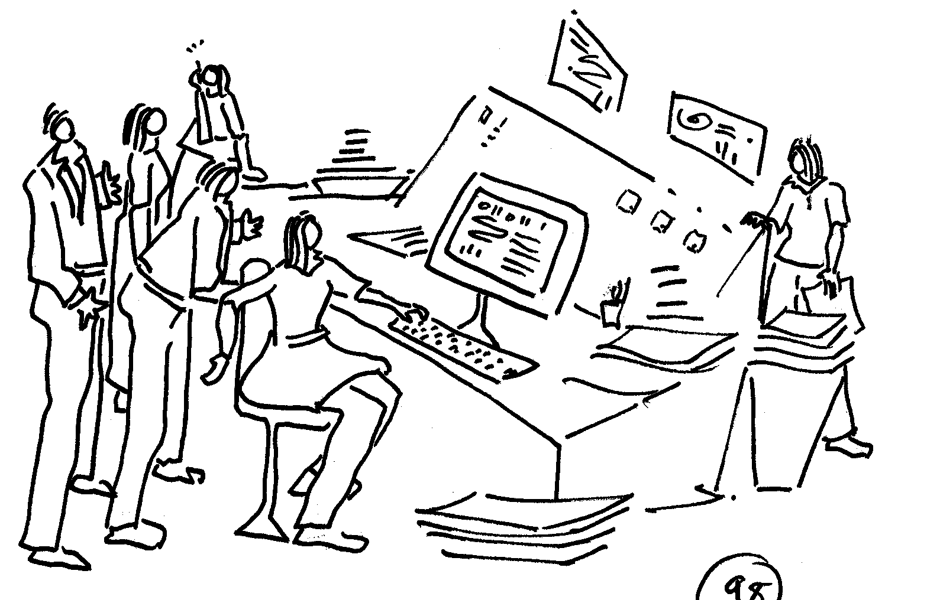
How do we learn?
Individual
Community & organizational
Systems

Slide 6
The multiple purposes of learning
Cognitive abilities (related to understanding)
Including learning to learn
Skills, know-how and mastery
Action competence and agency formation
Human and social development
Preservation of society (socialisation)
Conservation of values and traditions
New values and practices
Emancipation from oppressive ideas
Transformation, paradigm shifts and radical change
Cognitive Development
Practice Development
Social Development

Slide 7
Types of learning processes
Acquisition
Participation

Slide 8
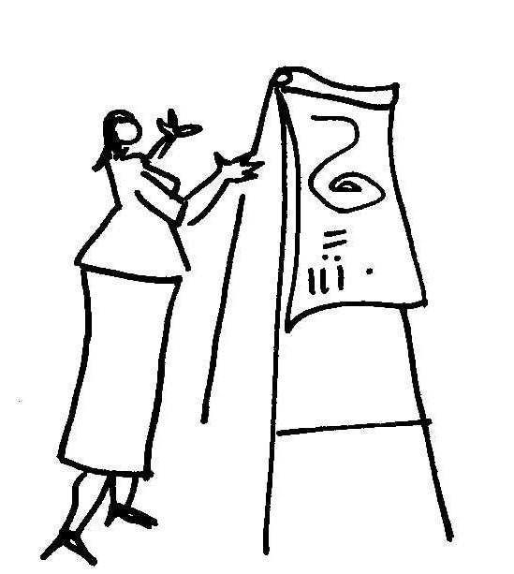
Learning through Transmission Teaching and Instruction
Transmission
Aimed at rote learning and the ‘absorption’ of facts and formulas
And intended behaviour change (e.g. Skinner, Hungerford & Volk)
Useful when new information must be conveyed
And for introducing ideas
Telling not showing or doing
Limitations for more complex tasks and learning purposes

Slide 9
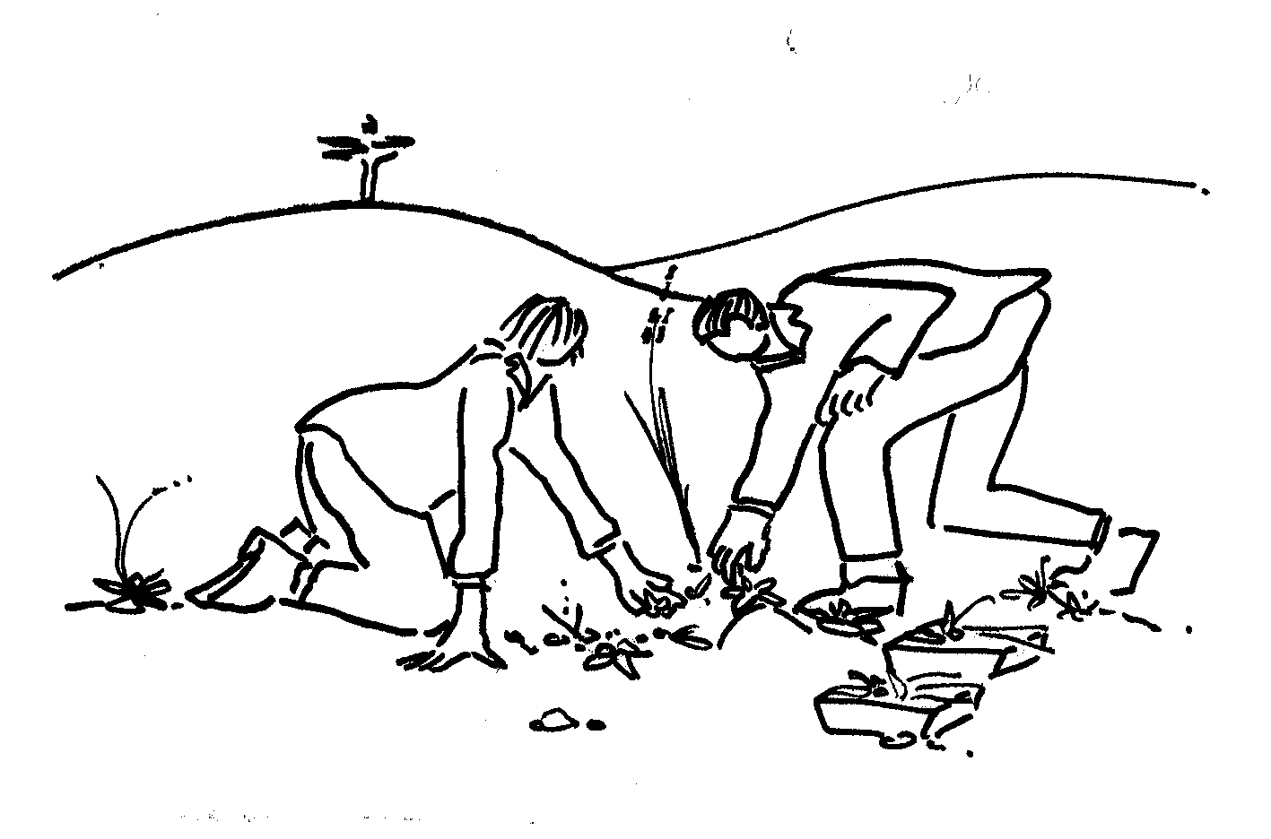
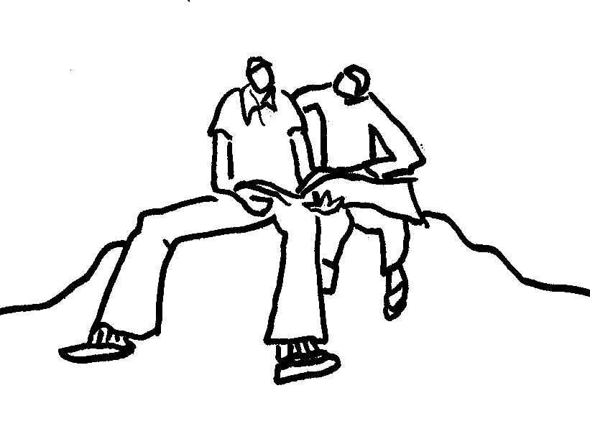
Learning By Doing
Participation
Experiential learning (Dewey)
O’Donoghue (environmental education)
Both practical skills and habits, agency formation

Slide 10
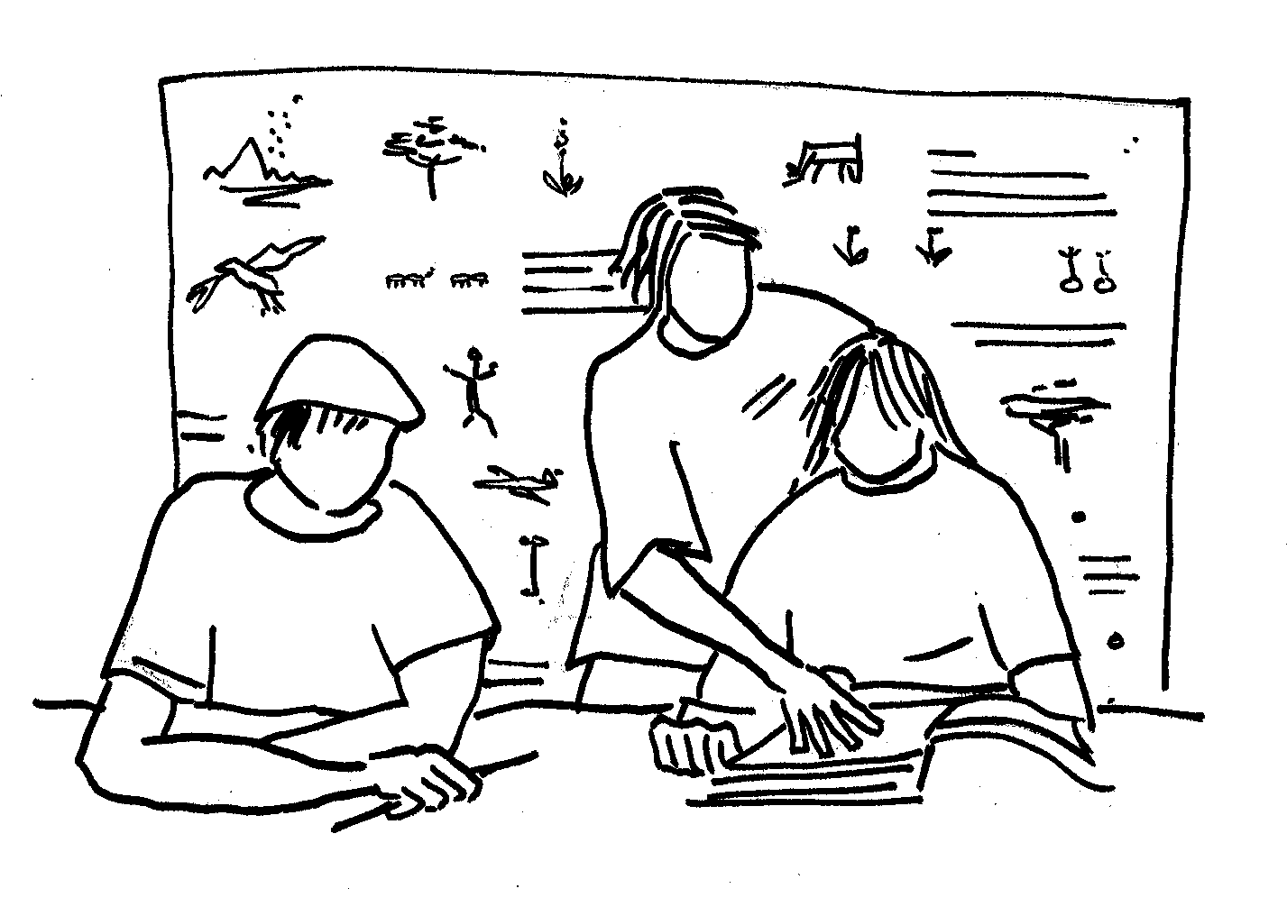
Learning through Concept Formation
Participation
Constructivism (Piaget, Bruner)
Internalisation,
semiotic mediation and
scaffolding in the zone of proximal development (Lev Vygotsky, 1930’s)

Slide 11
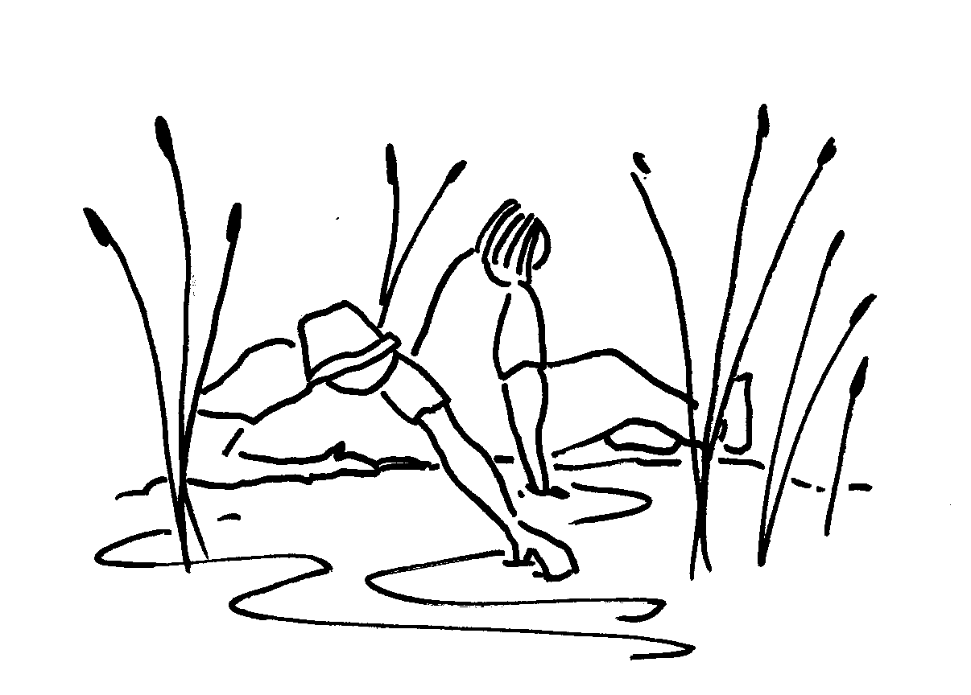
Learning through Experiences
Participation
Learning through interacting with the environment- John Dewey
Not just knowledge but values and dispositions
Often in the company of (significant) others

Slide 12
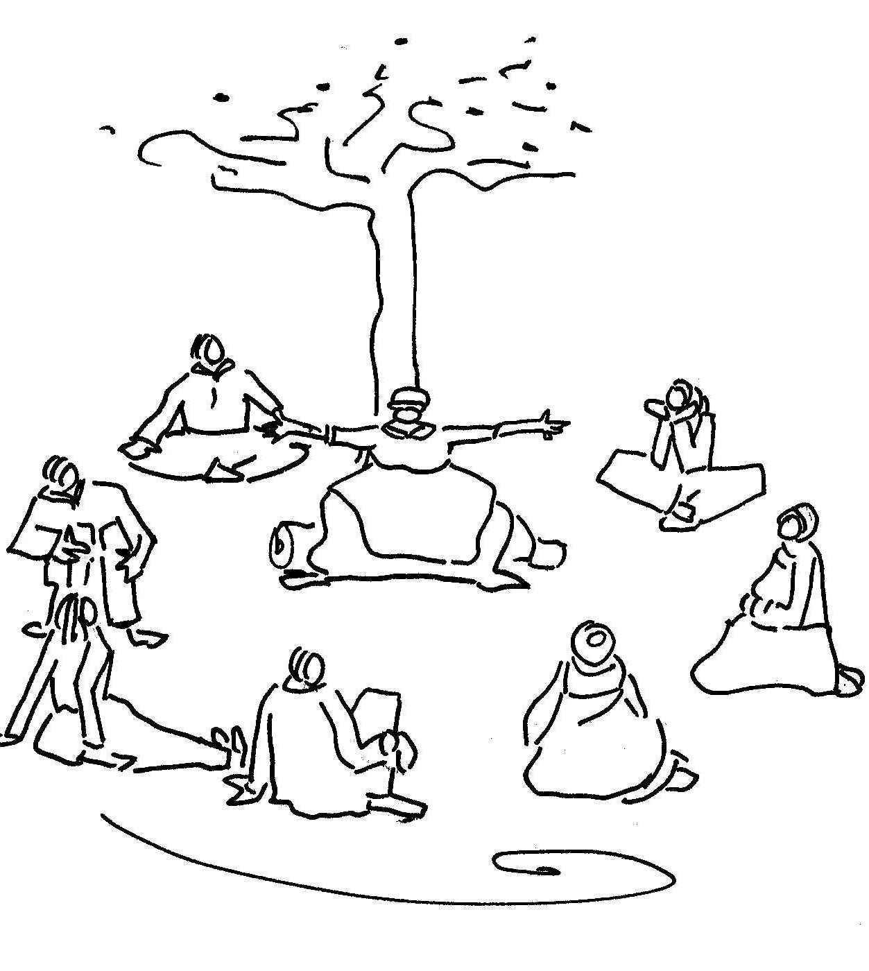
Learning through Socialisation
Participation
Induction into ‘ways of doing’
Modeling (Bandura, 1977)
Enculturation
Communities of Practices (Lave and Wenger, 1991)

Slide 13
Organisational learning
Participation
Forms of enculturation
Situated learning in Communities of practice (Lave & Wenger)
Expansive learning (Engeström & Sannino)
Systems learning (Senge)
Scaffolding (Vygotsky)
Single, double and triple loop learning
Reflexivity

Slide 14
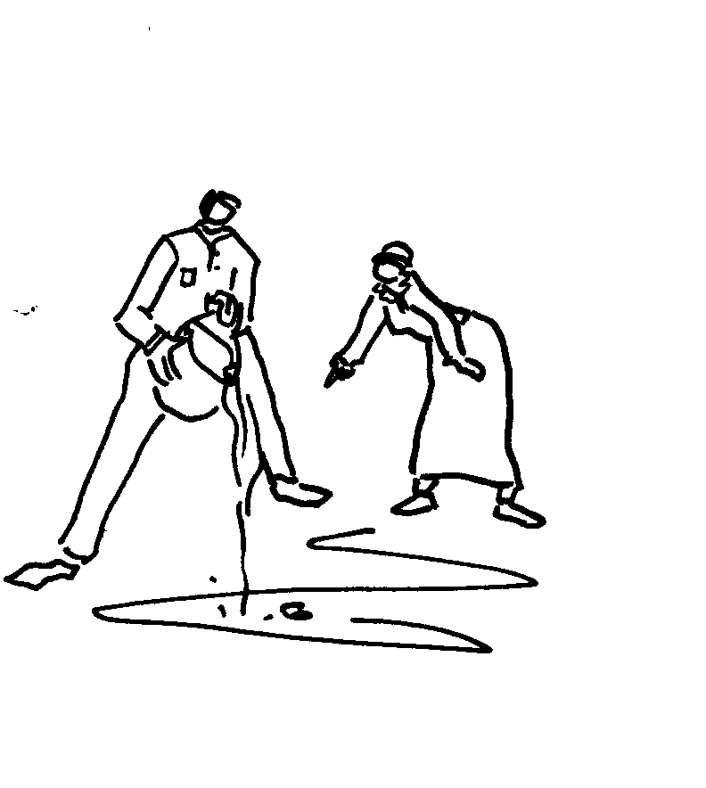
Learning through Conscientisation, Disruption
Participation
Emancipatory education (Paolo Freire, Pedagogy of the Oppressed, 1968)
Critical theory (Habermas) and critical pedagogy (Apple, Giroux, Mclaren, Patti Lather)
“There is no learning without dissonance; and there is no learning with too much dissonance” (Wals, 2007)

Slide 15
Learning through Deliberation
Participation
E.g. social learning discussed by (Wals 2007, Reed et al., 2010; Lotz-Sisitka et al., 2012).

