Slide 1

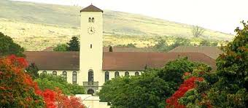

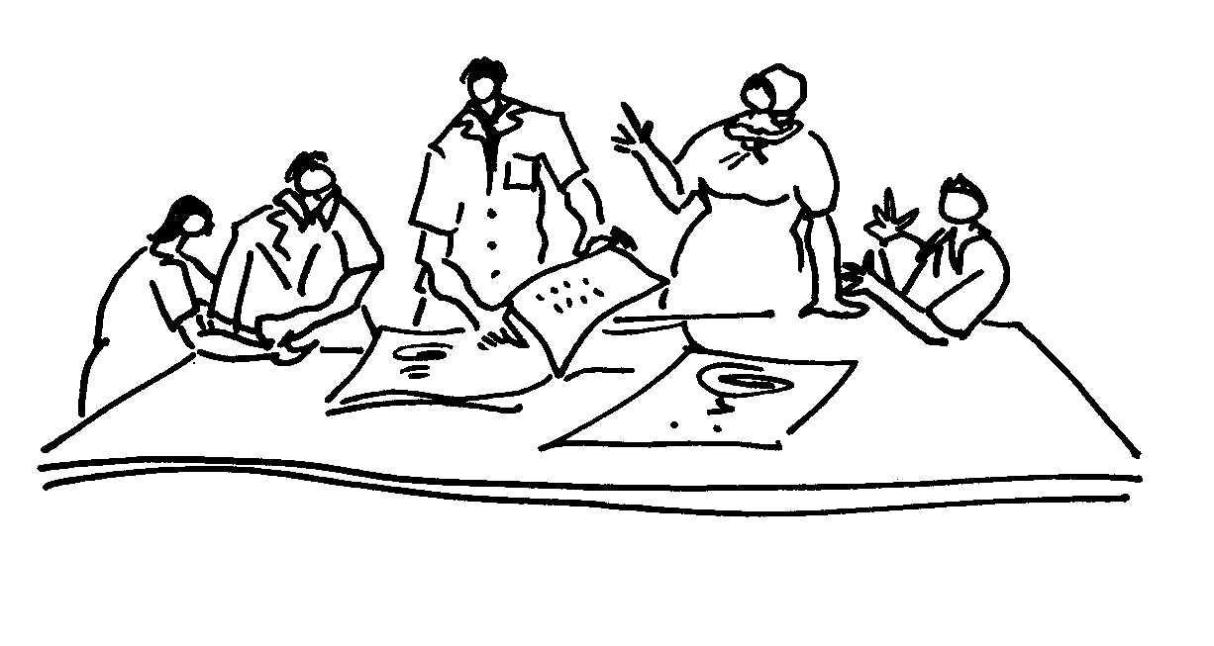

Meet your presenter:
Professor Eureta Rosenberg
Environmental Learning Research Centre
Rhodes University, Makhanda
Eastern Cape, South Africa
Facilitating Social Learning and Stakeholder Engagement in Natural Resource Management Contexts: Introductory Course

Slide 2
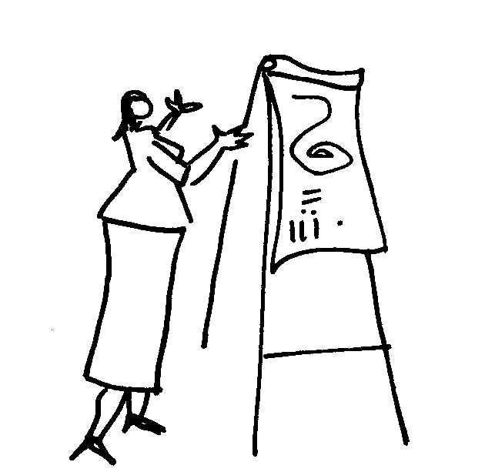
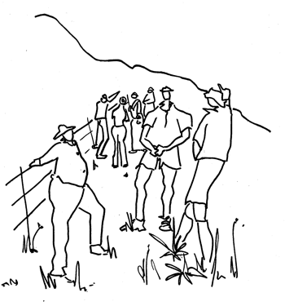
MODULE 1
TOPIC 1.2
Environmental Learning Facilitation and Stakeholder Engagement in NRM
Introduction by Prof Eureta Rosenberg
Facilitating Social Learning and Stakeholder Engagement in Natural Resource Management Contexts: Introductory Course

Slide 3
Activity: Put yourself in the picture of this course!
Let’s make a collage of selfies of course participants in their NRM contexts
Send your tutor a photo of yourself in a natural resource management context near where you live or work
How can you take the photo?
How can you send it?
Who is your tutor?
What is their contact details?
Is it safe for us to post this picture?
What is meant by a natural resource management context?

Slide 4
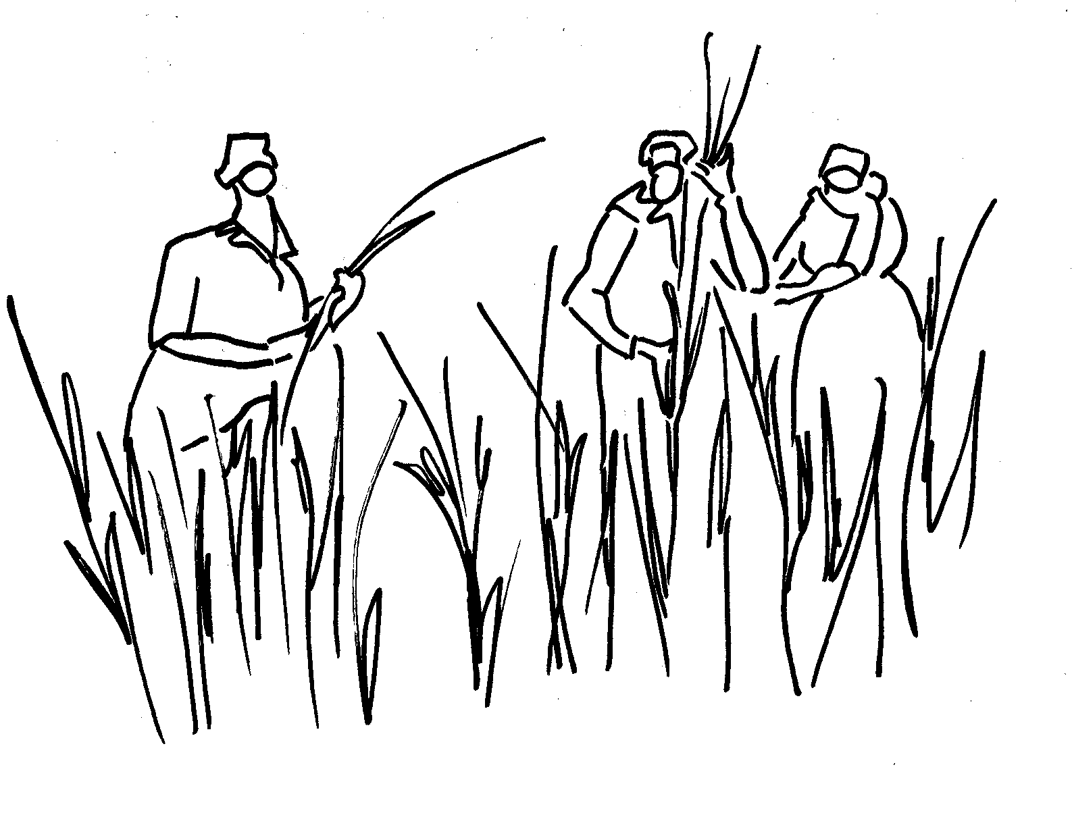
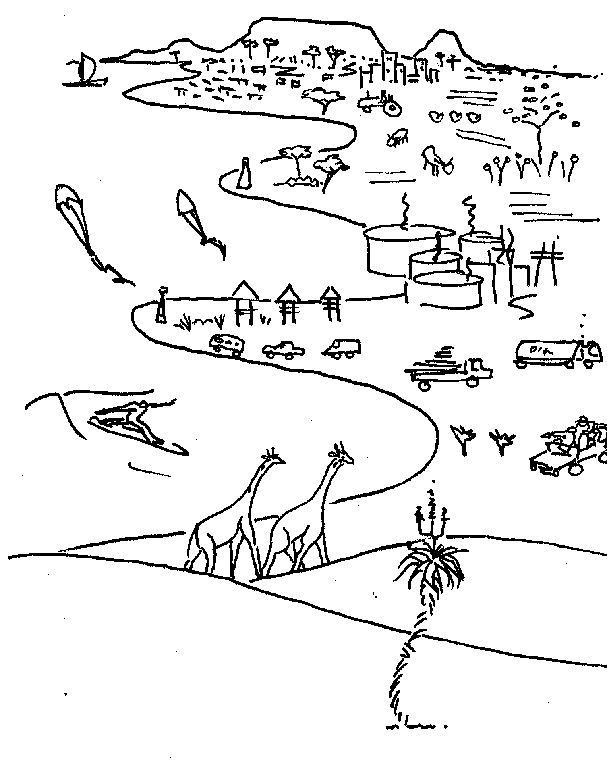
What is involved in natural resource management?
    NRM is about looking after nature in such a way that it can support people’s livelihoods and well-being, for this generation and their children’s children; while also making room for the other creatures with which we share the planet
Question: How many terms
do you know for “nature”?
People working and volunteering in NRM and doing this course find themselves in different organisational contexts ...

Slide 5
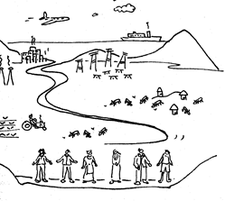
What is involved in natural resource management?
The choice of NRM action may be:
environmental monitoring,
compliance monitoring and enforcement,
pollution clean-up,
alien clearing and land restoration,
integrated water resource management,
nature conservation,
eco-tourism,
climate smart agriculture,
conservation agriculture,
agroforestry ....
IMAGE CREDITS:
ELRC / C.A.P.E. Conservation Education Project.

Slide 6
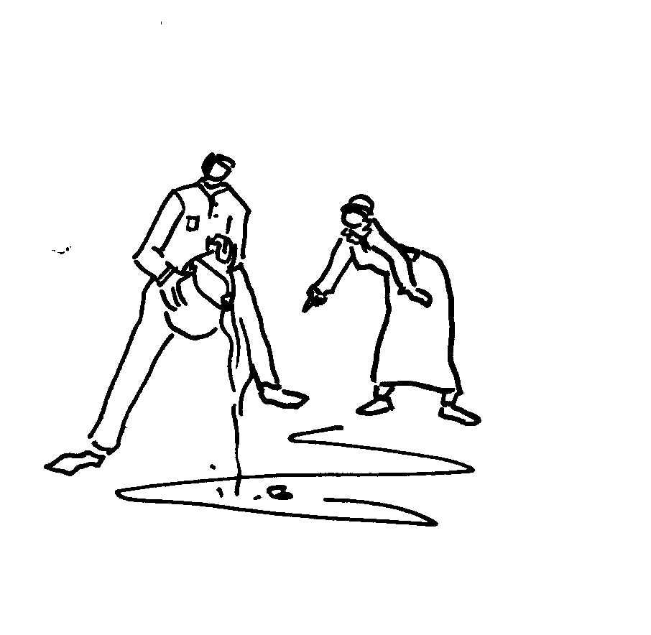
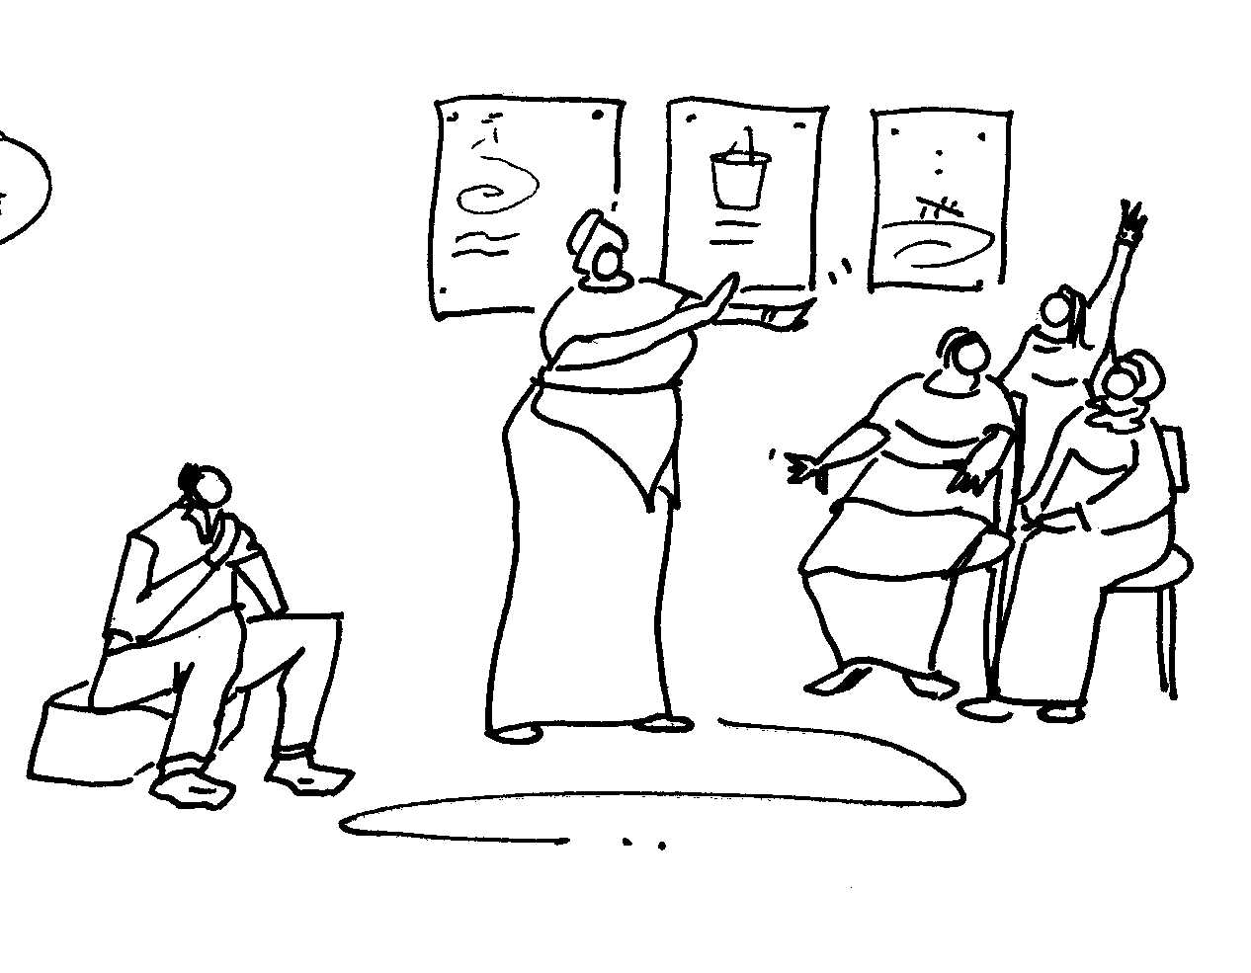
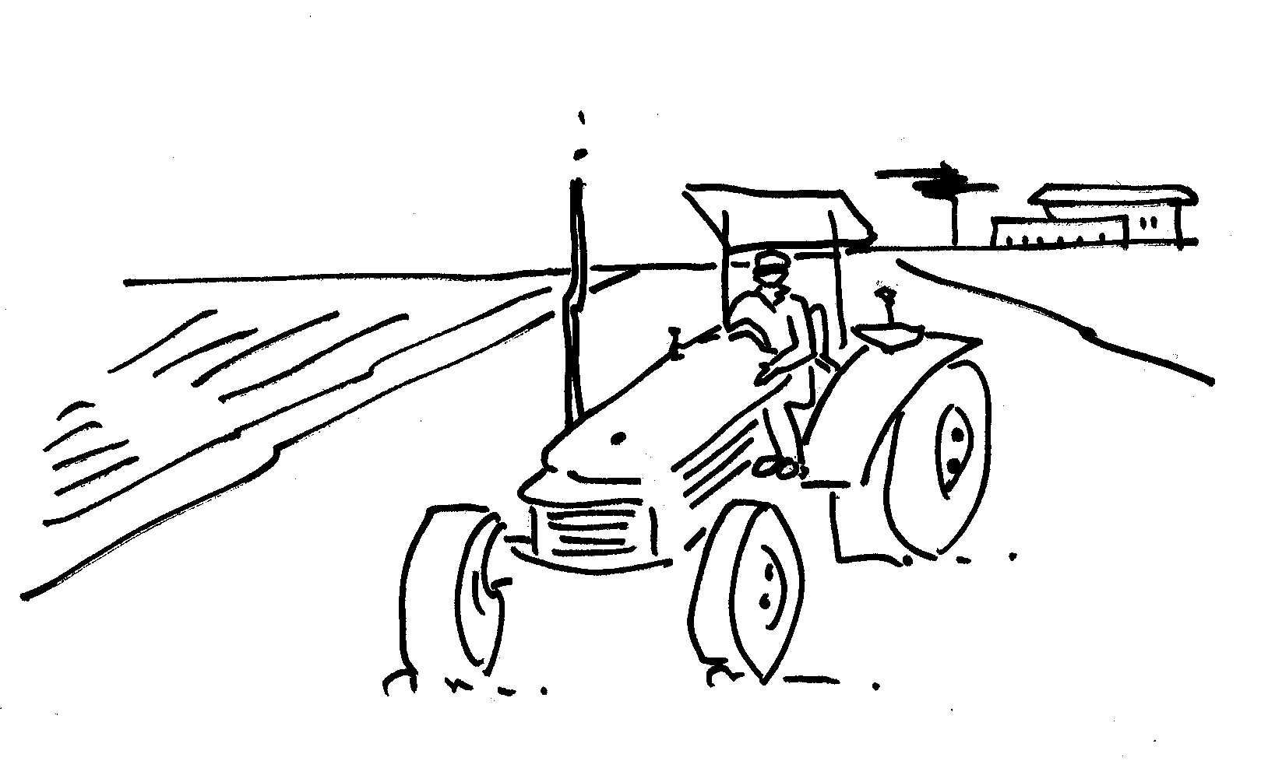
WHO is involved in natural resource management?
We engage people as learners or as other kinds of stakeholders, because:
Their actions, inactions or decisions may cause NRM problems
They may in future be affected by NRM related issues
They may already be affected by the problem
They could help to solve the problem; their participation is needed for successful NRM
We need to learn from them in order to better understand NRM issues and/or solutions (this is often the motivation for stakeholder engagement, e.g. by researchers or project managers).

Slide 7
Activity: Identifying NRM Stakeholders & Learners
Explore and Add to Table 2.1 in Your Topic Hand-Out
Types of NRM contexts | Stakeholders | Who must learn Why?
Threats to wildlife and nature
Eco-Tourism
Invasive alien plants and animals
Pollution of rivers and wetlands
Sewage spills
Soil degradation
Overgrazing
Integrated Water Resource Management
Rivers and wetlands drying up
Climate change
Add your own:

Slide 8

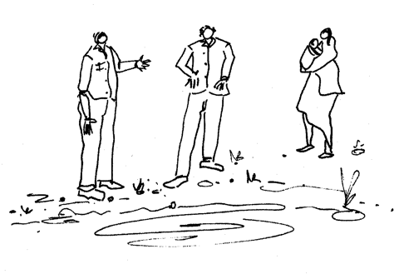
Who has to learn in NRM and why?
As scientists, activists, authorities, educators and facilitators, we often assume that the other person has to learn.
In NRM, there has been an increasing recognition that all parties need to learn from each other and from available new information, if there is going to be better NRM as a result.
Now we have placed people in the NRM picture!

Slide 9
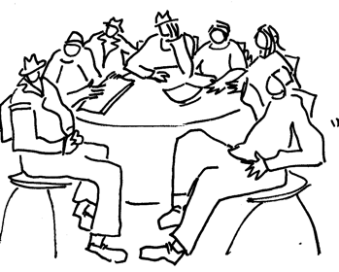
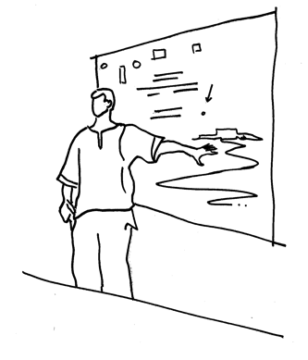
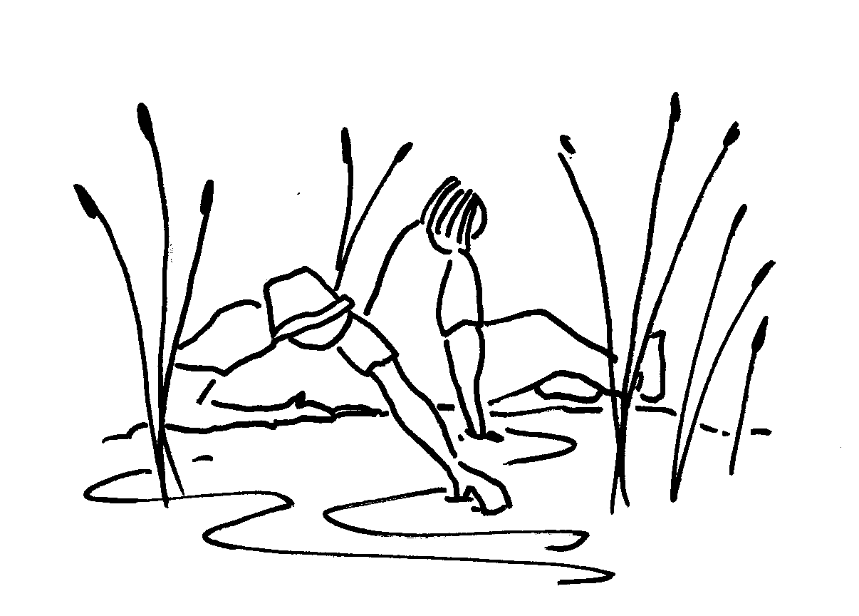
What is involved in learning, education, training and facilitation?
Formal, non-formal, informal
Education
Training
Facilitation
Learning takes place when we gain new knowledge, new understandings, new insights, and new skills. Learning can also involve unlearning certain things that were previously true or helpful, or that we thought were true or helpful, but were actually not.
We learn from our experience, from books, or research, or nature, from previous generations and from each other.

Slide 10
What knowledge is useful?
Over time, environment and sustainability educators have recognised the need to broaden the sources of information we use for NRM related learning.
It can be tempting to think that scientific knowledge or the information provided by government are the only or the most important sources of information. Why would that be a mistake?
Researchers realise that scientific knowledge is always partial or incomplete. There is always more to discover and learn. Researchers working in different disciplines also know that other disciplines can teach them more about the same topic.
But what about other forms of knowledge? Other ways of knowing about and understanding nature and natural resources, the associated issues and responses, that are not discipline-based, academic, or based on formal scientific research?
If you’d like to read more, see the Hand-Out for references (e.g. De Souza Santos).

Slide 11

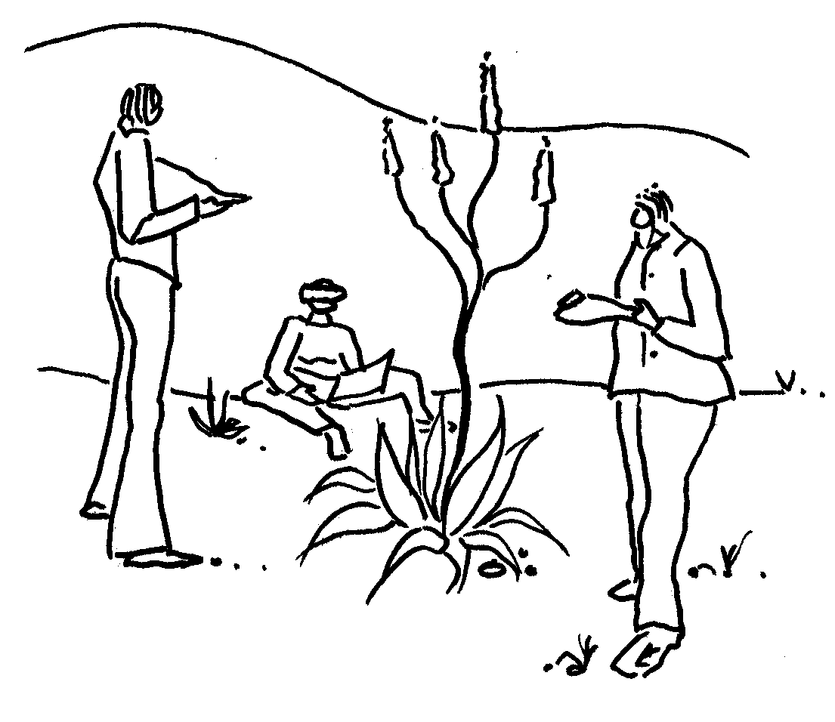
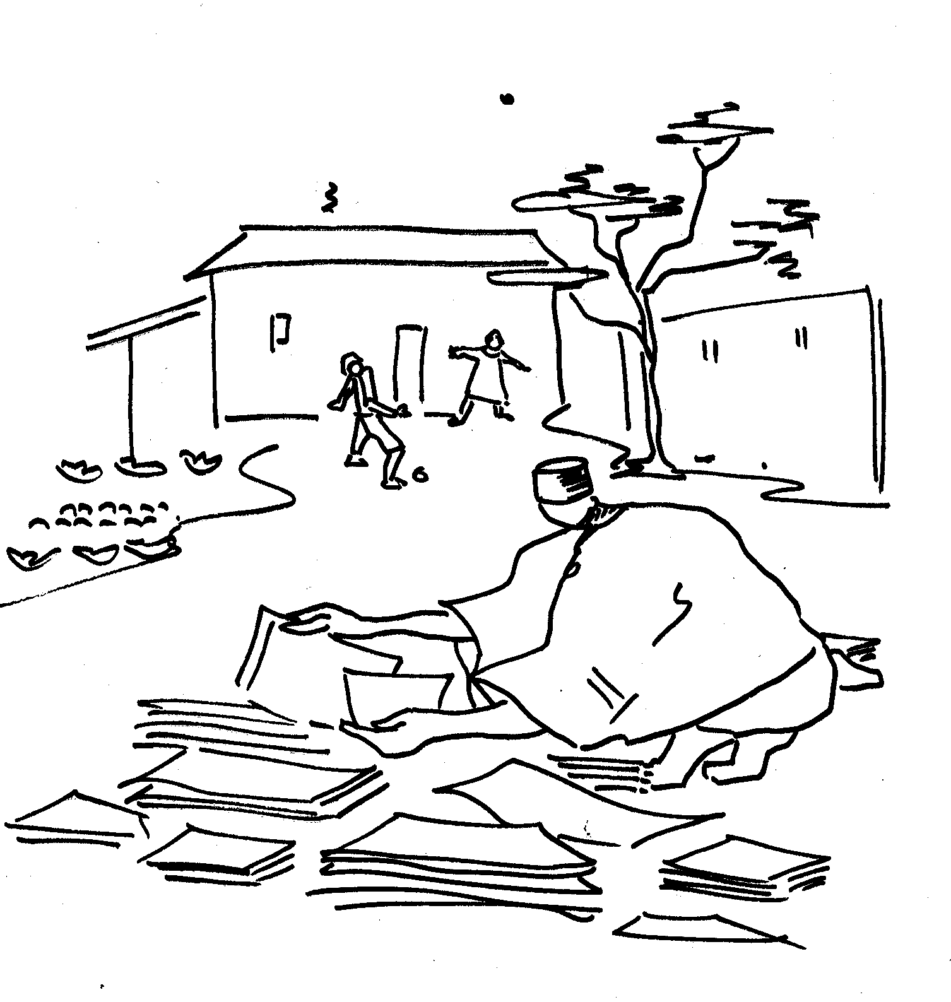
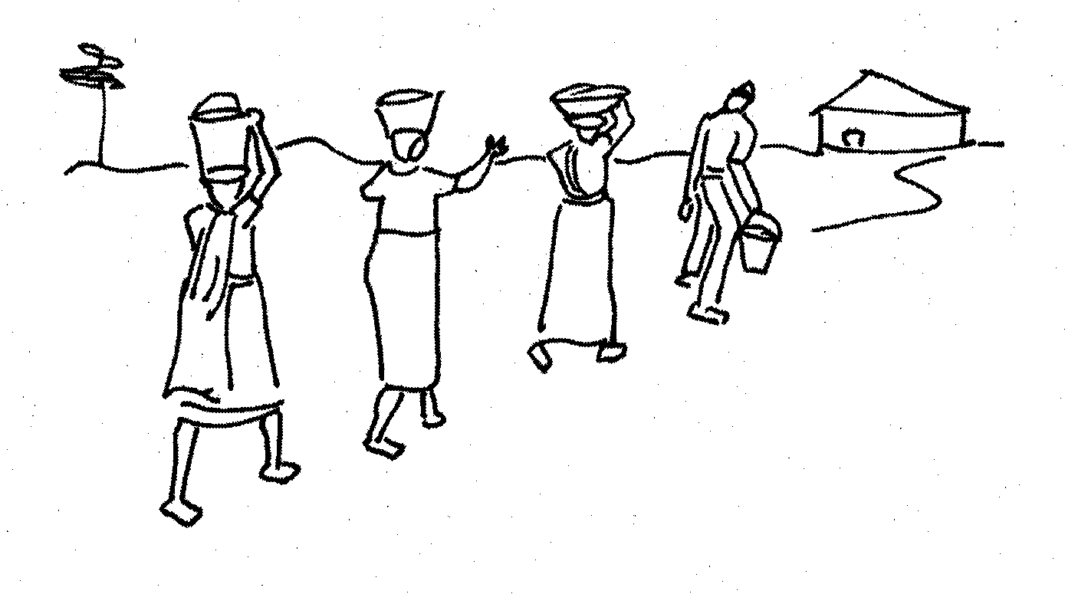
Activity: Explore Modern Western Science Advantages and Limitations
Can you identify some advantages of modern western-based science? Can you think about problems caused by this science? What can be done about the problems, so that we do not lose the benefits?
Other forms of knowledge include …
experiential knowledge
traditional and indigenous knowledge
(African, Eastern or Western)
local and situated knowledge
tacit knowledge
intuition or ancestral knowledge.

Slide 12
To close off the presentation …
Activity: Quizz
In your own context, and in your own words, explain …
  … what is meant by NRM?
  … as many reasons as possible why people should be involved in NRM
  … who all need to be doing the learning in NRM?
  … what are some of the different dimensions of learning?
  … some of the terms for the processes through which learning is supported?
In modules 2 and 3 of the course, we will explore these learning facilitation processes in some depth. See you there!

