Slide 1


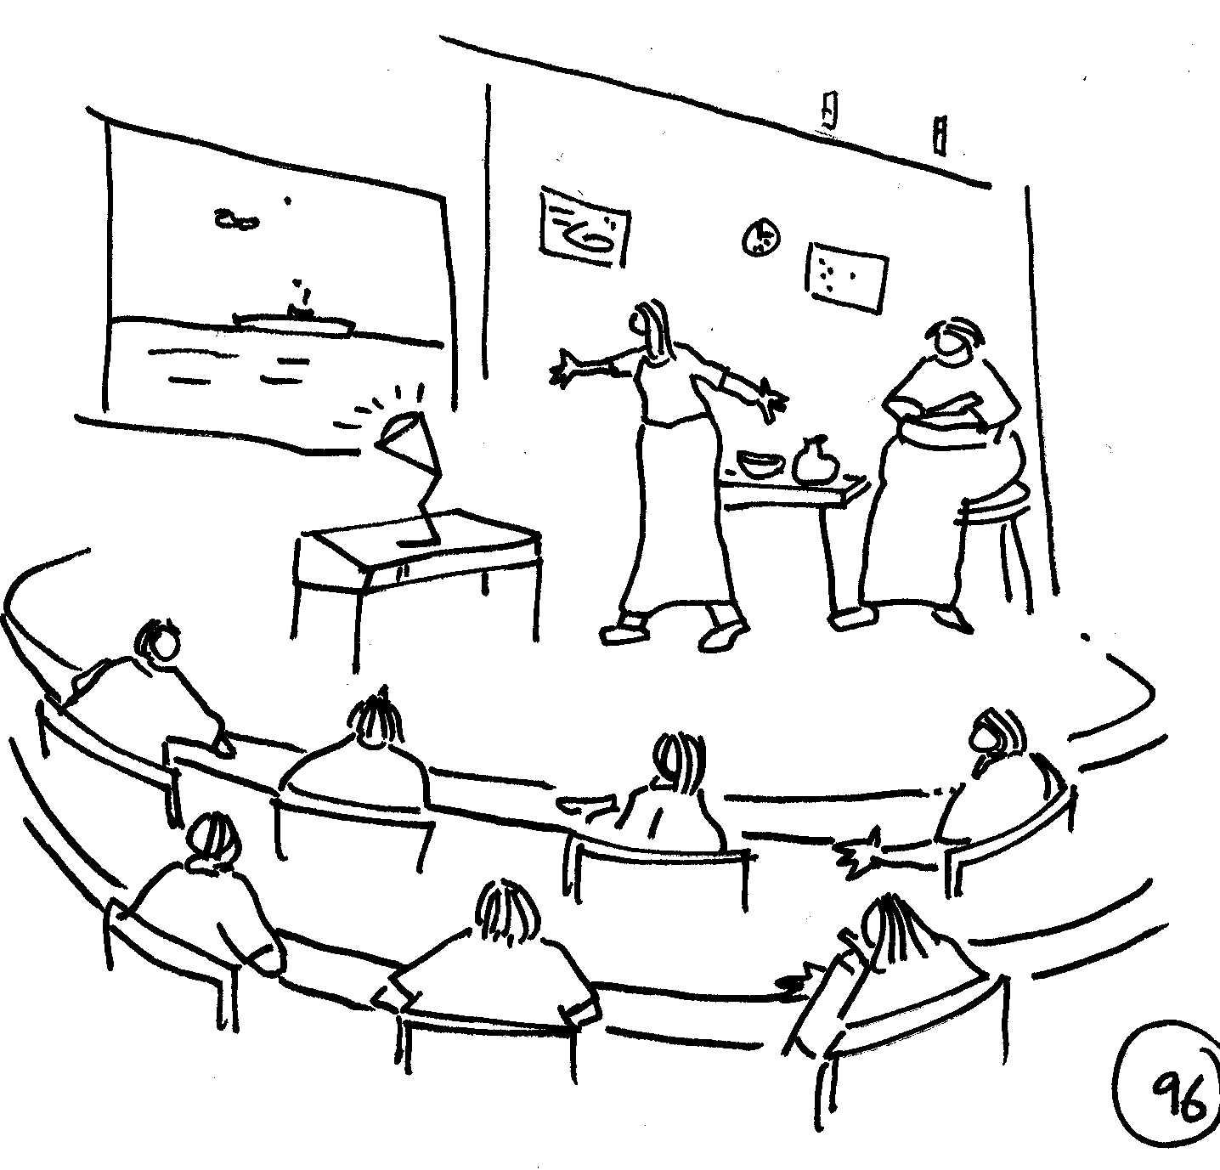


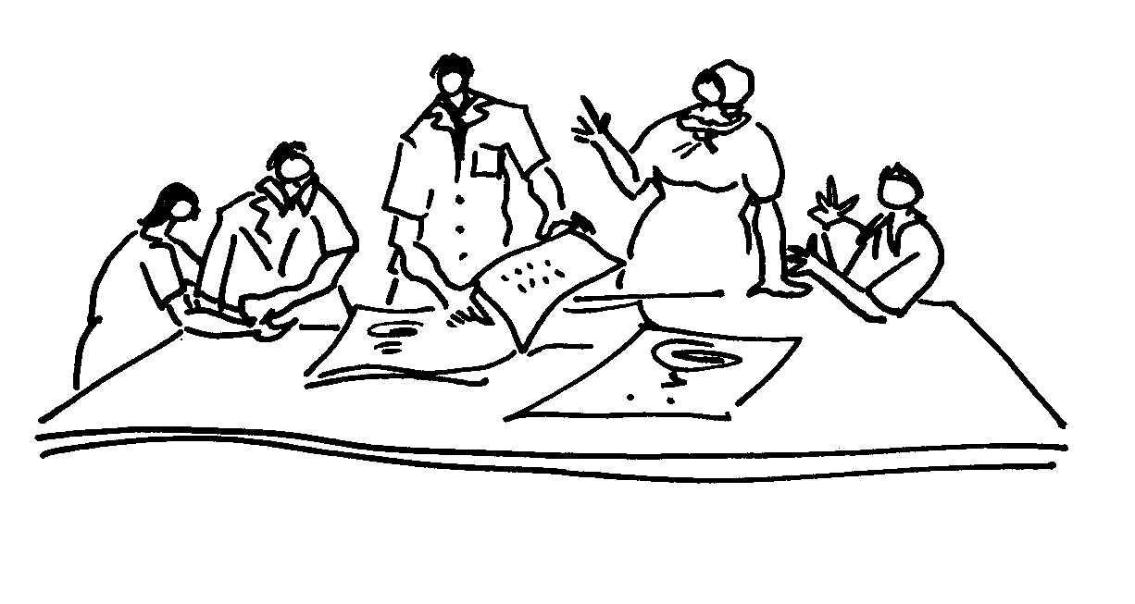
Training of Trainers
Module 2: Stakeholder Engagement
Purpose, Processes, Principles and Practicalities
Introduction to Module 2
Presenter: Matthew Weaver
Facilitating Social Learning and Stakeholder Engagement in Natural Resource Management Contexts: Introductory Course

Slide 2

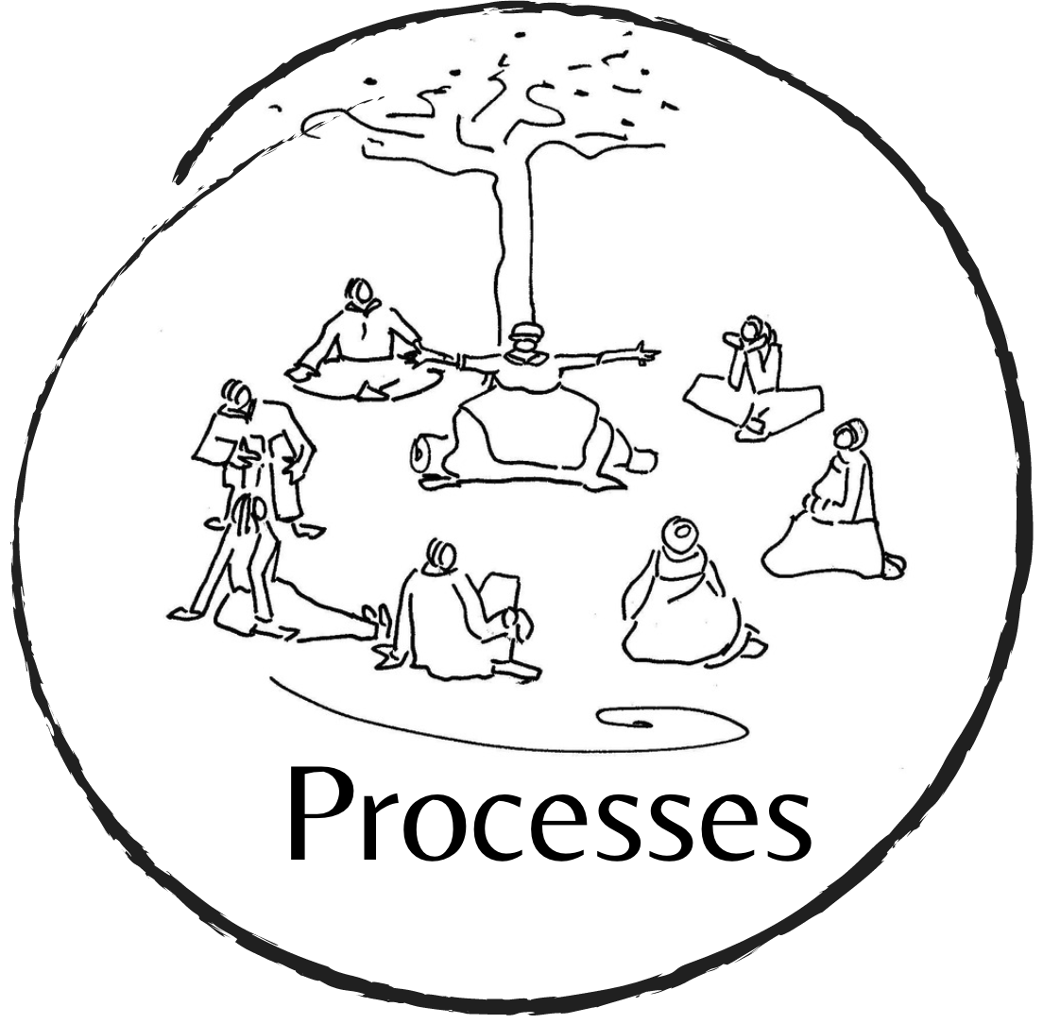

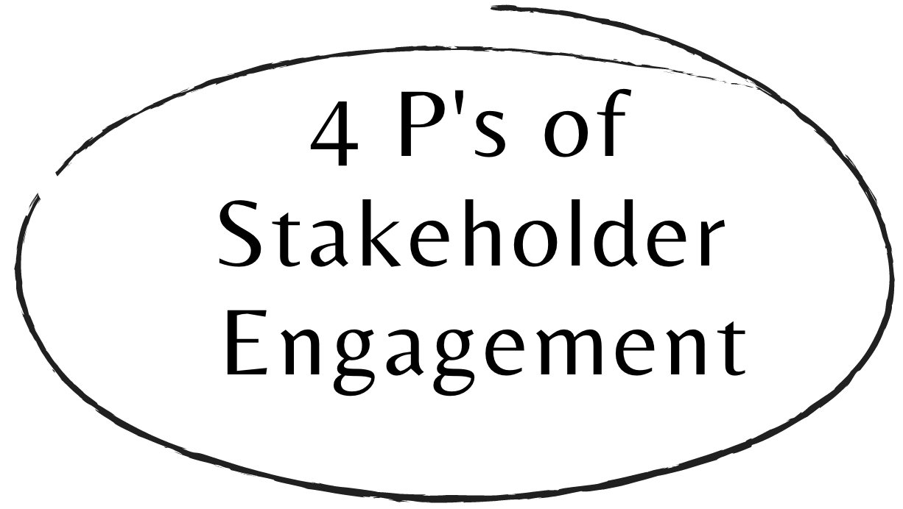

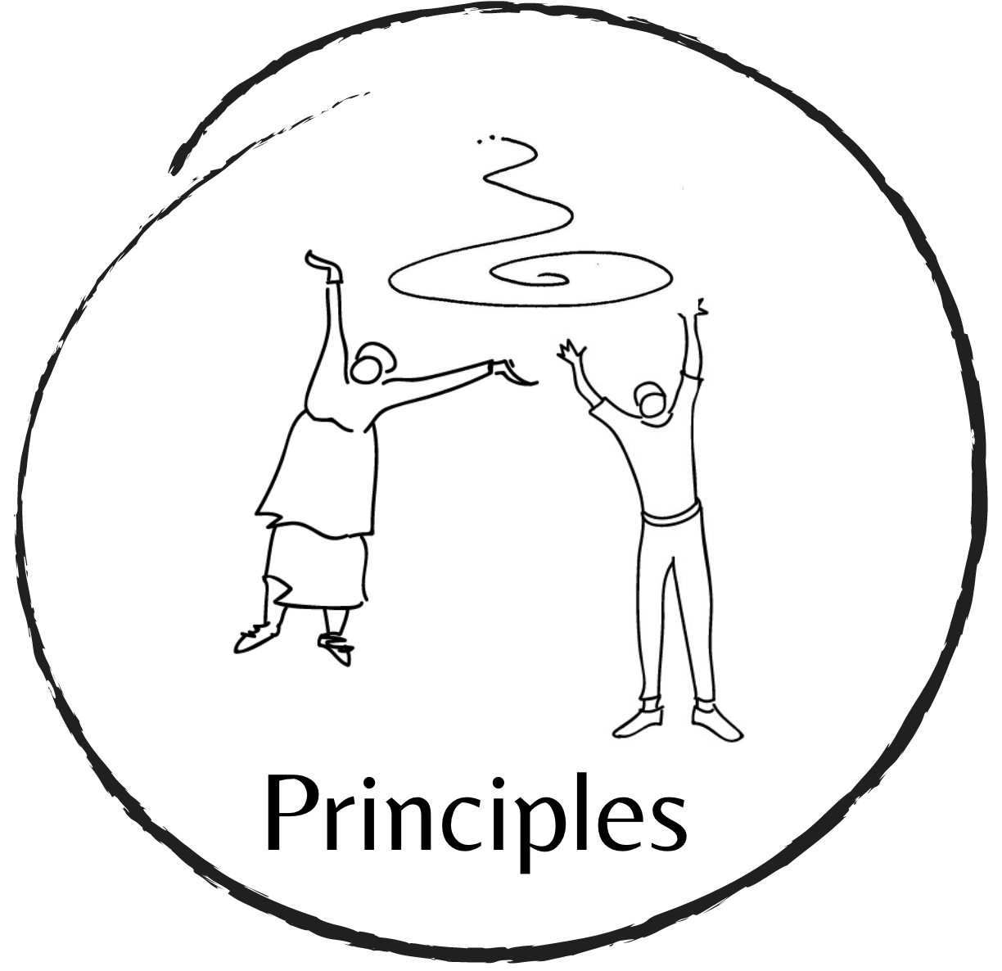
Module 2: Stakeholder engagement overview
Matthew Weaver
Topic 2.1
Topic 2.2
Topic 2.4
Topic 2.3
Facilitating Social Learning and Stakeholder Engagement in Natural Resource Management Contexts (Training of Trainers): Introductory Course
Notes:
This Module provides a baseline understanding of the ‘four Ps’ of stakeholder engagement, namely, the PURPOSE, PROCESSES, PRINCIPLES and PRACTICALITIES of stakeholder engagement in the context of learning processes for Natural Resource Management (FIGURE 1.0). There is a topic for each of the four P’s, which together form the content for Module 2:
PURPOSE: Why are we exploring stakeholder engagement on this course? Sometimes we (course participants) work with (other) scientists, managers, developers or government officials in a process that engages stakeholders and we need to support them in that; and sometimes stakeholder engagement is the precursor for a deeper learning process that we will be facilitating. For both these reasons, we need to know the basics of stakeholder engagement.
PROCESSES: How we do stakeholder engagement. What are some of the different processes, methods and tools that can be used for stakeholder engagement in natural resource management contexts?
PRINCIPLES: Regardless of the methods or processes we use, there are some key principles of stakeholder engagement (that, therefore, apply to all of the above). In this topic, we will discuss the principles of respect, reciprocity, truthfulness and transparency and reflexivity where they are evident, what challenges relate to them and how we can overcome them.
PRACTICALITIES: What are the practical considerations that we should take note of when designing and implementing a stakeholder engagement process? In this topic we will discuss considerations such as the role of the facilitator, knowing your participants, responding to group dynamics, the set-up of the room, building trust, enabling full participation, designing suitable activities, managing energy levels and closing the process.

Slide 3

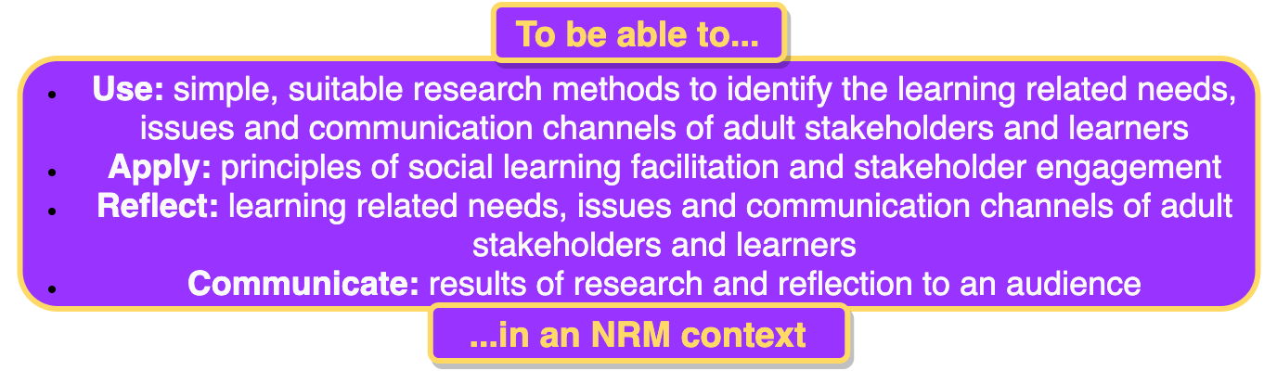
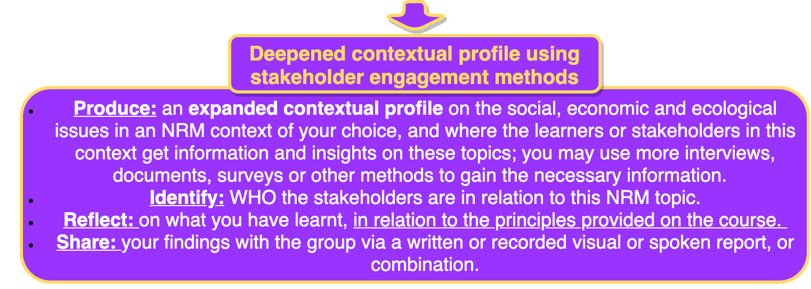
Learning Outcomes

Slide 4
Module 2 Overview
Week 1 16 - 20 Nov | Introduction to Module 2 Feedback on Assignment 1 Overview of Assignment 2 | Group Check-in Session (zoom) Handouts & Guidelines | Small group, peer discussion
 | Topic 2.1 PURPOSE of STAKEHOLDER ENGAGEMENT | Narrated Powerpoint Handout | Readings Small group, peer discussion
Week 2 13 - 27 Nov
 | Topic 2.2 PROCESSES of STAKEHOLDER ENGAGEMENT | Narrated Powerpoint Handouts Expert Videos | Readings Small group, peer discussion
Week 3 30 Nov - 4 Dec
 | Topic 2.3 PRINCIPLES of STAKEHOLDER ENGAGEMENT | Narrated Powerpoint Handout | Readings Small group, peer discussion
Week 4 7 - 11 Dec | Topic 2.4 PRACTICALITIES of STAKEHOLDER ENGAGEMENT | Narrated Powerpoint Handout Expert Videos | Readings Small group, peer discussion
 | Additional Assignment Support Module 2 Assignment in focus | Assignment guideline | Small group, peer discussion

Slide 5
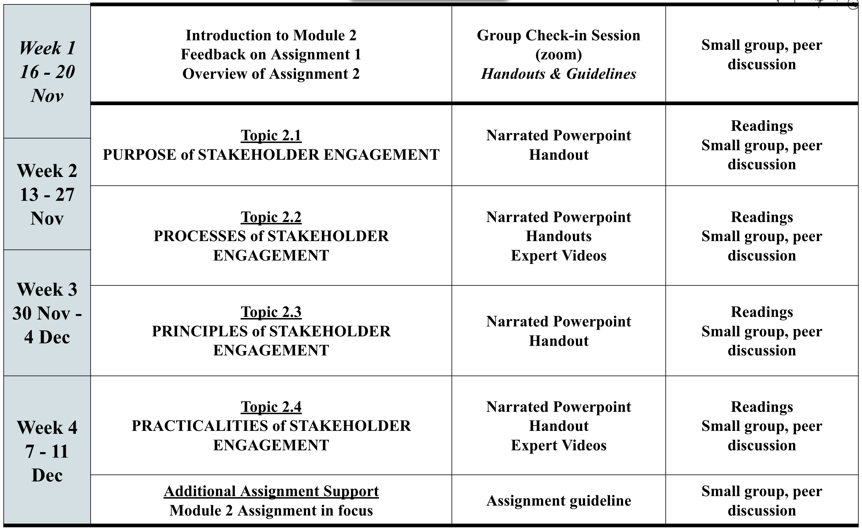

Module 2 Important Notice!
Matthew Weaver
Important note about readings. Only the handout is compulsory. Additional readings provided are optional

Slide 6

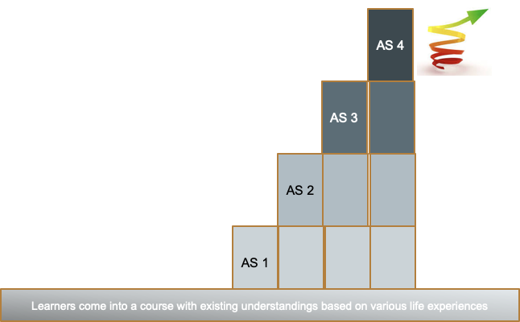
Assignments and Assessment Process
Assignments build upon one another - learning by doing, receive feedback, improve for the next assignment
Assessing course participants’ assignments to support learning to become better at facilitating engagements and mediating learning.
Assignments are not graded -
Completed or not with careful
feedback from tutors supported
by course facilitators
Implement & evaluate learning/ stakeholder engagement process
Design learning/ stakeholder engagement process
Deepened contextual profile
Simple contextual profile
Facilitating Social Learning and Stakeholder Engagement in Natural Resource Management Contexts (Training of Trainers): Introductory Course

Slide 7
Assignment 2 overview
Eureta Rosenberg & Monde Duma
Assignment 2 Task
Using the structure provided, produce an expanded contextual profile on the social, economic and bio-physical issues in an NRM context, and where the learners or stakeholders in this context get information and insights on these topics; use more interviews, and/or documents, surveys or other methods and processes and tools (e.g. some presented in Topic 2.2) to gain the information. Focus on the same NRM issue(s) as in Assignment 1, or change the focus as you see fit. Identify who the stakeholders are in this NRM context (refer to Modules 1 & 2) Reflect on what you have learnt, in relation to the principles in Modules 1 & 2 NB: Use feedback received on Assignment 1 to improve your Assignment 2. Record and share your findings in a written / visual/spoken report, or a combination, and upload your assignment or send to your tutor as agreed.
Facilitating Social Learning and Stakeholder Engagement in Natural Resource Management Contexts (Training of Trainers): Introductory Course

Slide 8
What is coming up in Module 2 Week 1
Matthew Weaver
 | Module 2 Activity Schedule |  | Module 2 Activity Schedule
Day | Week 1 (and 3) |  | Week 2 (and 4)
Mon | 1:45 - 4 pm Group Check-in - Welcome and Setting the Scene. All Participants & Tutors via zoom |  | No Group session Participants work away and connect with your tutors
Tue | Participants work away and connect with your tutors |  | Participants work away and connect with your tutors
Wed
Thu | 11 - 12:30 pm Tutor and Dual-Participant Tutor Reflection and Planning Meeting (Tutors and Dual-participant Tutors only) | Participants work away and connect with your tutors | 1 - 12:30 pm Tutor and Dual-Participant Tutor Reflection and Planning Meeting (Tutors and Dual-participant Tutors only) | Participants work away and connect with your tutors
Fri | Participants work away and connect with your tutors |  | Participants work away and connect with your tutors
Facilitating Social Learning and Stakeholder Engagement in Natural Resource Management Contexts (Training of Trainers): Introductory Course

Slide 9


Closing and thank you
Matthew Weaver
May the learning continue!
All the best for Module 2
Image credits:
ELRC / C.A.P.E. Conservation Education Project.
IWR Line Drawings. How To Handbook Series
Facilitating Social Learning and Stakeholder Engagement in Natural Resource Management Contexts (Training of Trainers): Introductory Course

