Slide 1
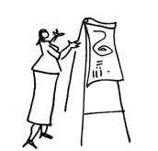
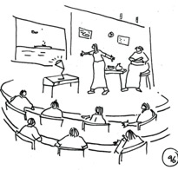


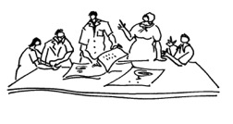
MODULE 2 TOPIC 4:
PRACTICALITIES of STAKEHOLDER ENGAGEMENT:
Facilitation Methods, Tools and Practicalities
INTRODUCTION
By Matthew Weaver and Eureta Rosenberg
Facilitating Social Learning and Stakeholder Engagement in Natural Resource Management Contexts: Introductory Course

Slide 2
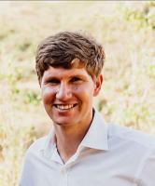

Meet your facilitators and contributors
for this topic:
Dr Matthew Weaver
Ru: Institute for Water Research (IWR) & Environmental Learning Research Centre (ELRC)
Prof. Eureta Rosenberg
RU: Environmental Learning Research Centre (ELRC)
Facilitating Social Learning and Stakeholder Engagement in Natural Resource Management Contexts: Introductory Course

Slide 3

Overview of this presentation
Orientation - How to think about facilitation techniques.
The Basics:
  Understand your role and the purpose of the engagement,
  Get to know the context and participants,
  Anticipate and respond to group dynamics,
  Manage the physical set-up,
  Allow people to trust you, each other, and the process,
  Enable everyone’s participation,
  Design activities that are fit for purpose,
  Keep up the energy levels,
  Provide a satisfying closing of the process.
Facilitating Social Learning and Stakeholder Engagement in Natural Resource Management Contexts: Introductory Course

Slide 4

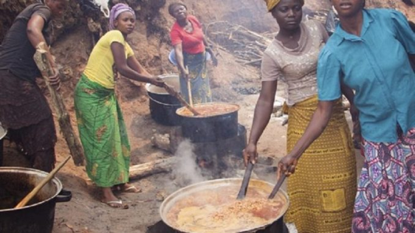
Orientation - How to think about facilitation techniques
No one size fits all facilitation technique.
A skilled facilitator:
  Considers different contexts, processes and purposes,
  Keeps the underlying principles in mind,
  Adaptive - responsive to emergence (what pops up) from within and outside.
Intention of this Topic - provide considerations, not a bag of tricks.
https://www.foodingredientsfirst.com/
https://weafriquenations.com/
Facilitating Social Learning and Stakeholder Engagement in Natural Resource Management Contexts: Introductory Course

Slide 5

Understand your role and the purpose of the engagement
Hold and steer a process so that the group produces an outcome that is better than any individual can do.
Outcomes are not predetermined.
Allow everyone to participate and contribute optimally.
Purpose (the why) guides process (the what).
Facilitating Social Learning and Stakeholder Engagement in Natural Resource Management Contexts: Introductory Course

Slide 6

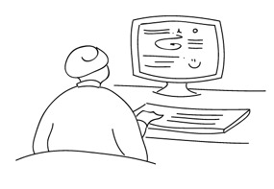
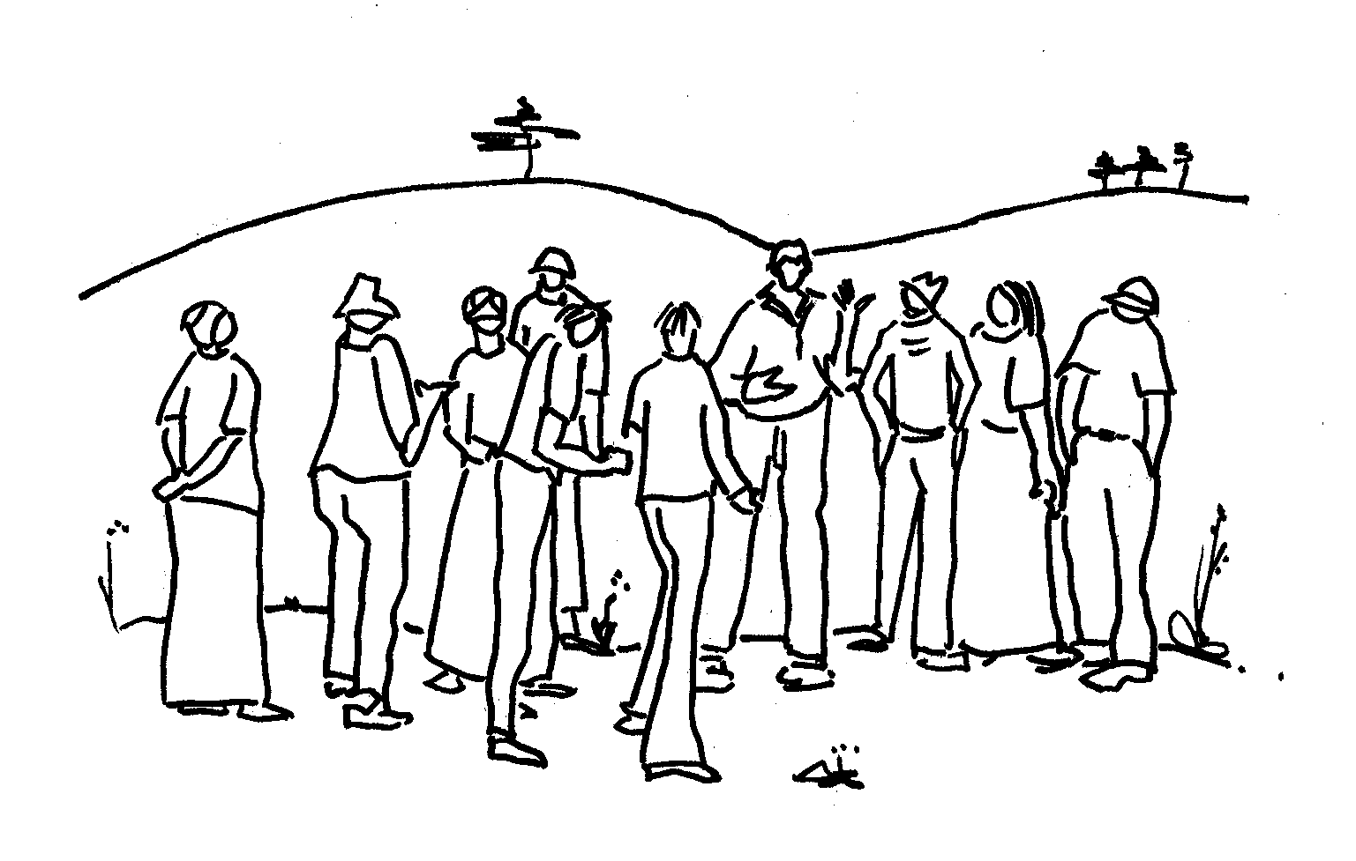
Get to know the context and participants
Do your homework:
  Understanding the context,
  Venue, equipment, possible activities, catering and travel time,
  Participants - composition, language, institutional, social, cultural norms.
On the day
  Expect and be prepared for surprises,
  Who is there at the start and late arrivals.
Facilitating Social Learning and Stakeholder Engagement in Natural Resource Management Contexts: Introductory Course

Slide 7

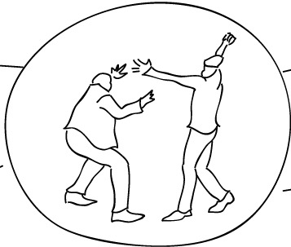
Anticipate and respond to group dynamics
Carefully identify and invite relevant participants.
Allow everyone to participate and contribute optimally.
Reduce the chance of conflict and exclusion:
  Agree on a Code of Conduct,
  Complex dynamics can prevent a process reaching a successful outcome.
Facilitating Social Learning and Stakeholder Engagement in Natural Resource Management Contexts: Introductory Course

Slide 8
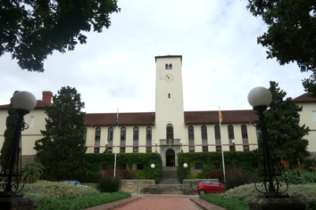
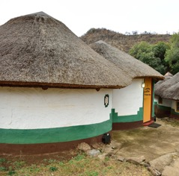
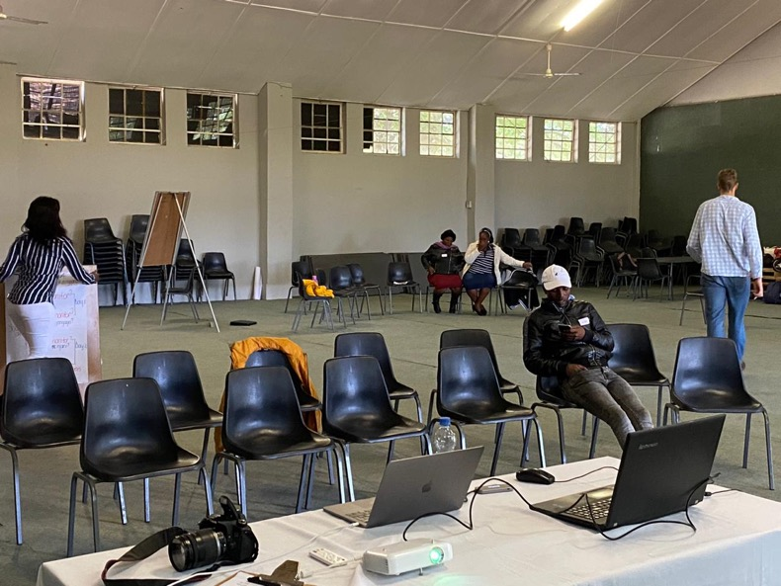
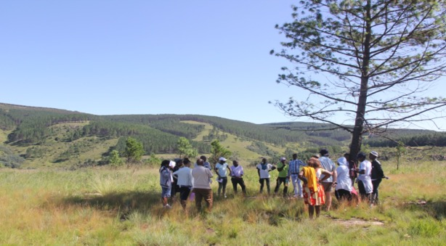
Manage the physical set-up
Choose an appropriate venue - symbolic meaning, distance...
https://www.ru.ac.za/tsitsaproject/
Facilitating Social Learning and Stakeholder Engagement in Natural Resource Management Contexts: Introductory Course

Slide 9

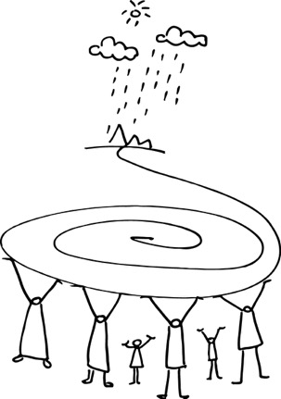
Allow people to trust you, each other, and the process
Building trust takes time - be respectful, reciprocating and transparent.
Allow time for participants to get to know you and each other.
Show some vulnerability, that you are real person.
Competence and dependability.
Always be truthful.
Be transparent about the intention of the process, expectations, motivations.
Facilitating Social Learning and Stakeholder Engagement in Natural Resource Management Contexts: Introductory Course

Slide 10
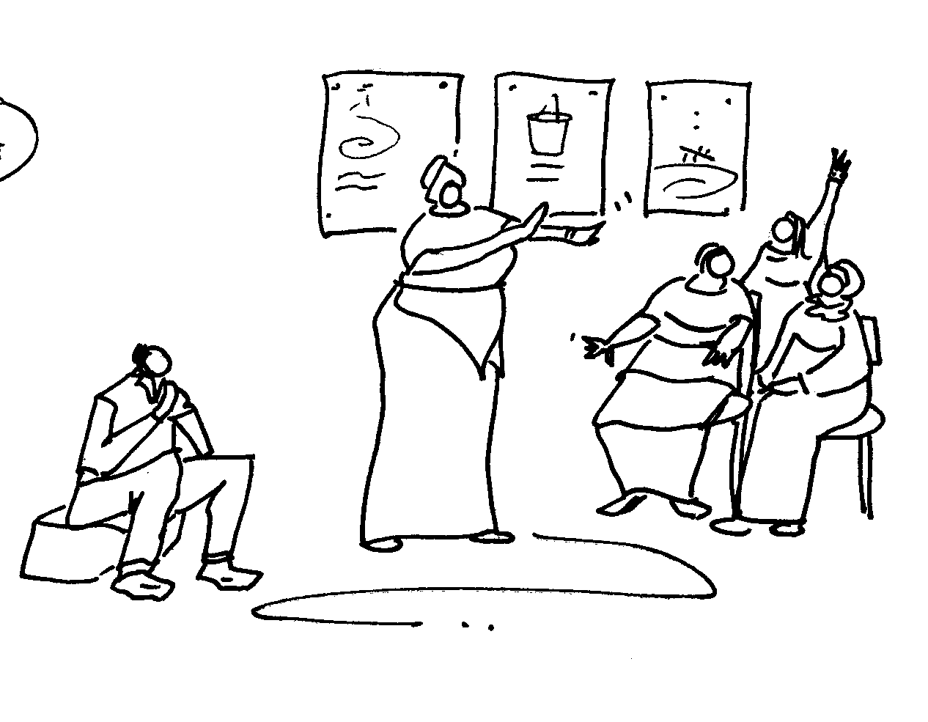
Enable everyone’s participation
Respect all contributions:
  Listening, clarify and capture, and link,
  Managing disruptive contributions.
Working with multiple languages - interpretation and translation.
Facilitating Social Learning and Stakeholder Engagement in Natural Resource Management Contexts: Introductory Course

Slide 11

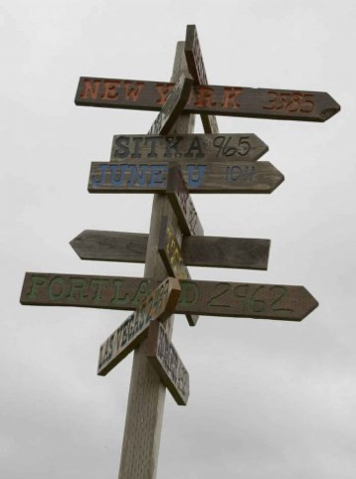

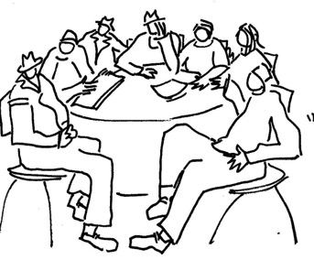

Design activities that are fit for purpose
Purpose determines process
Decision-making
Brainstorming
Facilitating Social Learning and Stakeholder Engagement in Natural Resource Management Contexts: Introductory Course

Slide 12



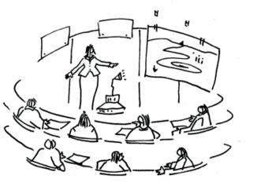


Keep up the energy levels
Judge the energy of the group.
Plan breaks after 45-90 minutes of focussed work.
Design your process and physical set-up to keep up energy levels.
Choose your catering carefully.
Ballance listening with engaging and interactive sessions.
Facilitating Social Learning and Stakeholder Engagement in Natural Resource Management Contexts: Introductory Course

Slide 13


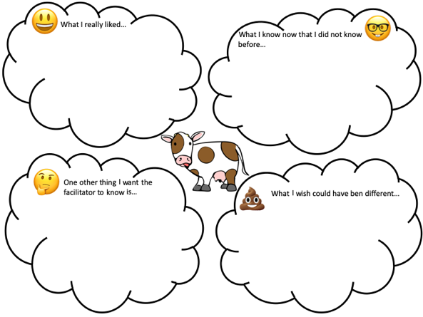
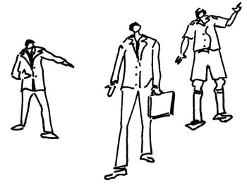

Provide a satisfying closing of the process
Make time for debriefing, reflection and next steps.
Use an attendance register.
Meaningful reporting is important.
Facilitating Social Learning and Stakeholder Engagement in Natural Resource Management Contexts: Introductory Course

Slide 14
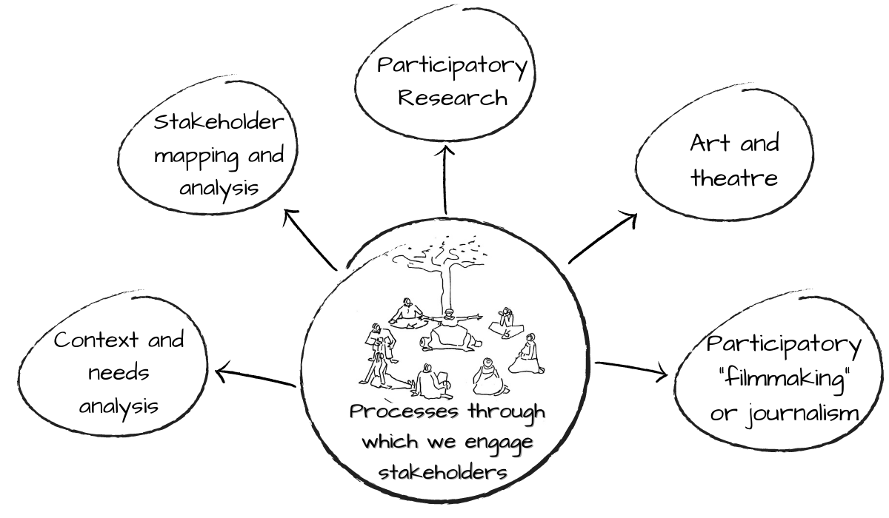
How to use Topic 2.4
Read the Handout.
Practicalities to consider when planning and implementing one of the processes suggested in Topic 2.2.
Facilitating Social Learning and Stakeholder Engagement in Natural Resource Management Contexts: Introductory Course

Slide 15


Thank you
All the best with applying these principles in your work and your assignment!
Image credits:
ELRC / C.A.P.E. Conservation Education Project.
IWR Line Drawings. How To Handbook Series
Facilitating Social Learning and Stakeholder Engagement in Natural Resource Management Contexts (Training of Trainers): Introductory Course

