Slide 1


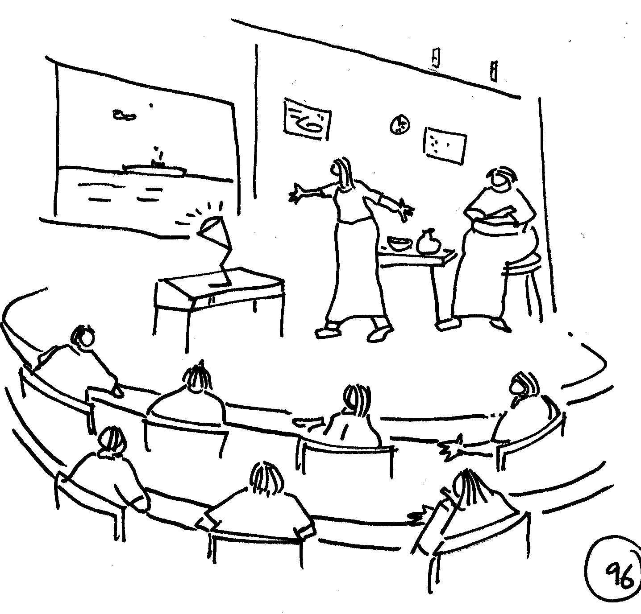



MODULE 1 TOPIC 5:
Research methods for researching learning-related needs
A brief introduction
Part 2
By Matthew Weaver & Monde Duma
Facilitating Social Learning and Stakeholder Engagement in Natural Resource Management Contexts: Introductory Course

Slide 2
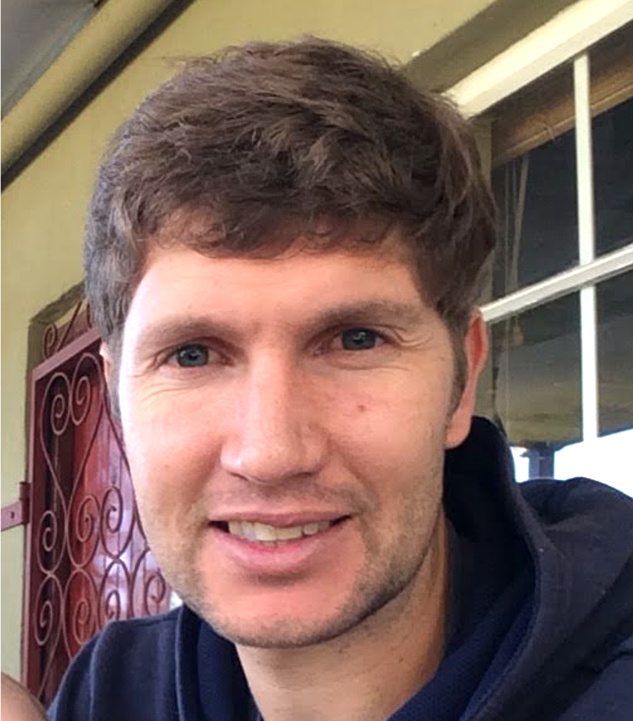
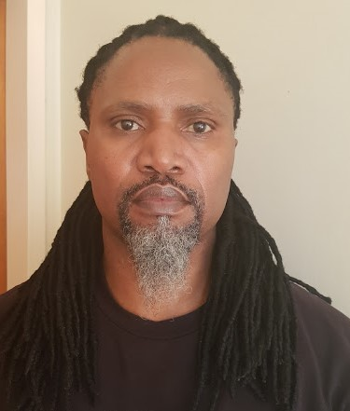
Meet some of your facilitators / teachers for this topic:
Dr Matthew Weaver
Environmental Learning Research Centre
Rhodes University
Mr Monde Duma
PhD Candidate
Department of Environmental Science
Rhodes University

Slide 3
Participant observation

Slide 4

Learning outcomes of this presentation on research methods for researching learning-related needs
Understand the participant observation method, how to conduct it and some of its strengths and weaknesses
Understand document analysis as a research method
Understand the difference between Extractive and co-creative research approaches

Slide 5



What is the (participant) observation method and why it is useful?
Research method to learn about people’s activities and behaviour by carefully watching and participating in those activities.
Good for research interested in “what people do”.
Complements other research methods and provides different types of data (e.g. body language, who talks to who, how people communicate (uses all 5 senses).
Types of Participant observation
Complete observer - outsider watching in, not involved in the discussion
Participant as observer - Member of the group (insider), full participant but also observing for research purposes
Observer as participant - People know your role, not an insider but contribute to discussions
Notes:
Can add where to conduct PO here - where do the subjects of your research conduct their practice? In the field, in meetings, in workshops at the workplace? These are the areas that you would conduct your observations in
What - Fieldwork involves "active looking, improving memory, informal interviewing, writing detailed field notes, and perhaps most importantly, patience" (DeWALT & DeWALT, 2002, p.vii).
"the process of learning through exposure to or involvement in the day-to-day or routine activities of participants in the researcher setting" (p.91). [2]
Different forms of participant observation
Participant as observer
Complete participant
Complete observer
Observer as participant
Why
Where
Who
How

Slide 6
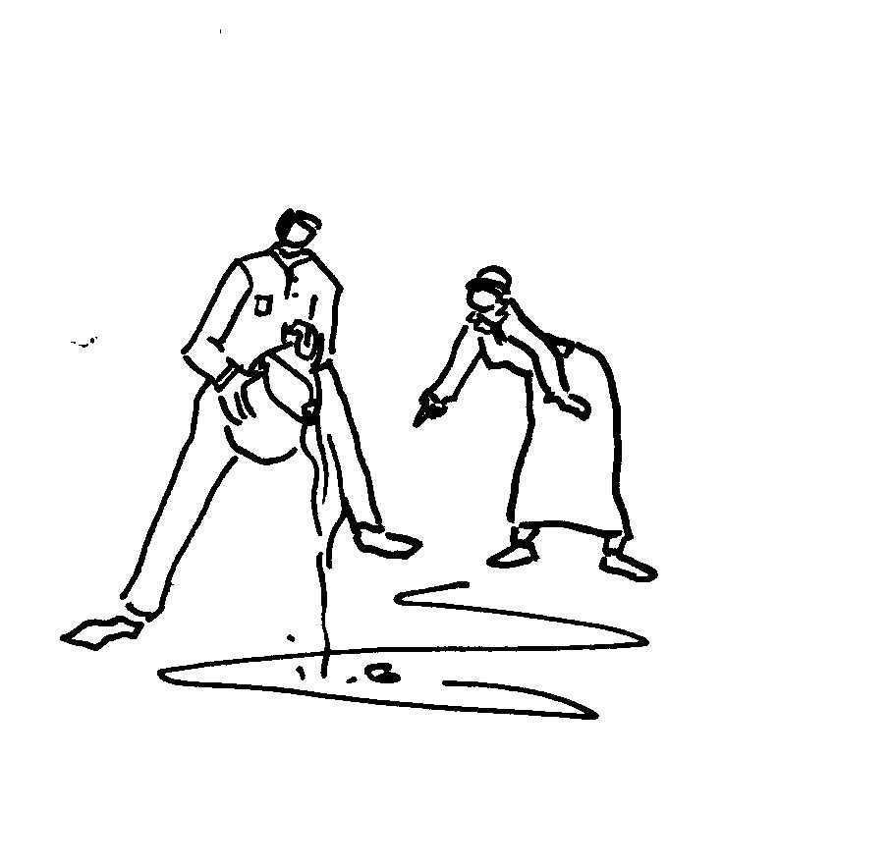


How to conduct participant observation
Gain entry or permission to observe in the study location (workplace, meeting, field, workshop etc.).
Establish a good relationship (rapport) with the people (research participants) under investigation.
Make sure you spend enough time with participants in the environment to get enough information (data) for your purpose (research study, report for your supervisor etc.).
Observation guide - e.g. who, when and where subjects are observed also what is observed, and how the observations are recorded.
Main tool used - written field notes - supplemented by photographs, audio and video clips (ethical considerations).

Slide 7
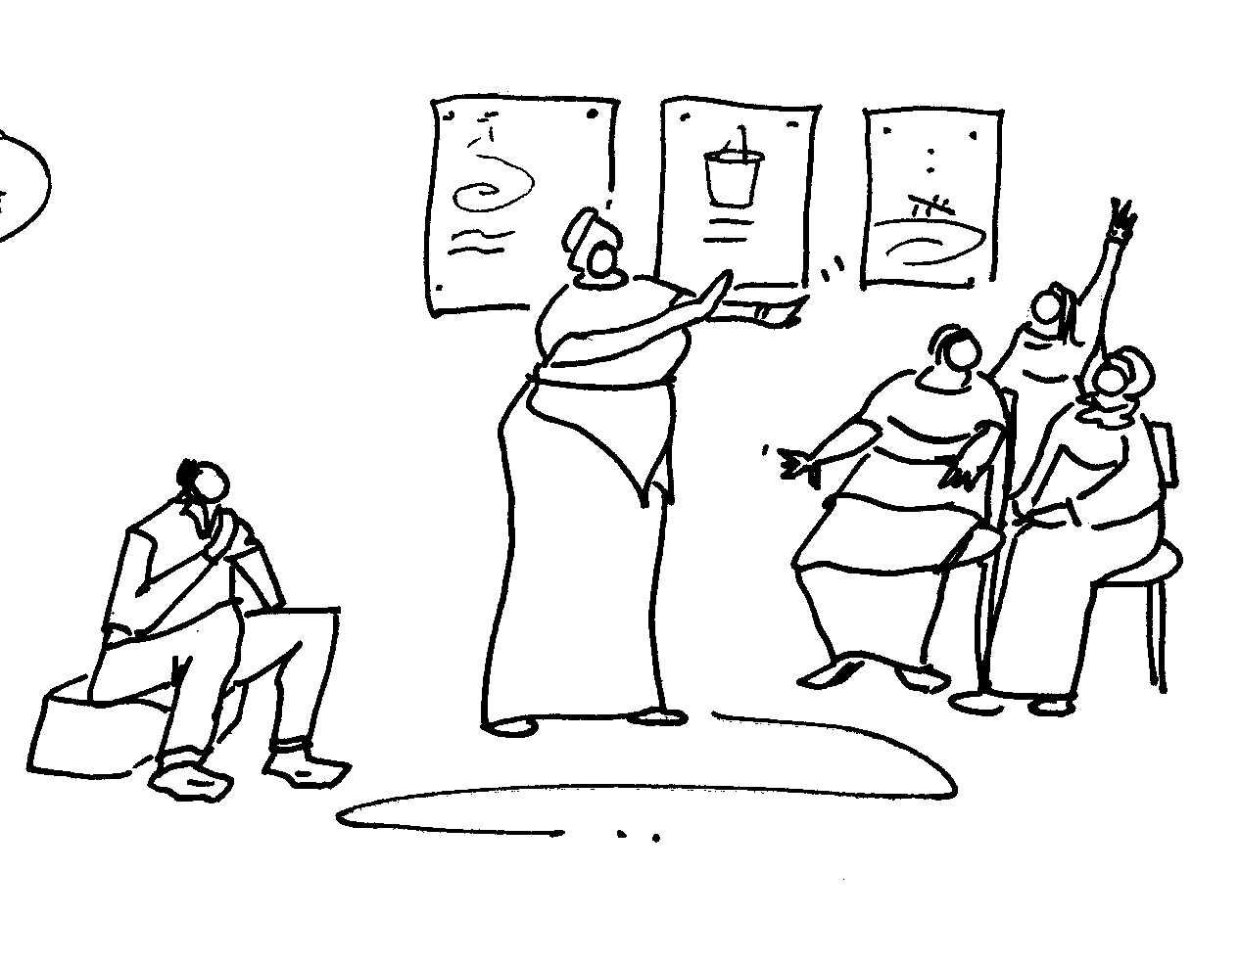
Some of the advantages and disadvantages of participant observation?
Disadvantages
Time-consuming – human resource-intensive
Observer bias - your might misinterpret what you are seeing
Role conflict (an active participant vs objective observer)
Too much data - overwhelming
Ethical issues - identity known or not - will people change their behaviour if they know you are observing them?
Advantages
Rich data - Depth of knowledge about subjects (experiences, perspectives, knowledge, behaviour, feelings about issues)
Unscheduled and spontaneous events
All information collected is potentially useful
First hand (primary), reliable and validated insight

